Slide 1
REGULATORY REVIEW AND PREDICTIONS
HENRY E. SEATON, ESQ.
SEATON & HUSK, LP
5TH ANNUAL AUTO HAULERS ASSOCIATION OF AMERICA’S
FALL EXPO AND CONFERENCE
OCTOBER 27-30, 2019
HILTON HEAD, SC

Slide 2
MAJOR ISSUES TO BE DISCUSSED
ELD AND HOS
THE FUTURE OF SMS METHODOLOGY AND FAST ACT COMPLIANCE
PREVENTABILITY
DEEP STATE POLITICS / GUIDANCE MASQUERADING AS RULEMAKING AND DYSFUNCTIONAL POLITICS
THE FUTURE OF THE INDEPENDENT CONTRACTOR MODEL

Slide 3
1. ELD AND HOS
ELD MANDATE TAKES FULL EFFECT IN DECEMBER
  EXPECT ENFORCEMENT TO BE DRACONIAN
  NUMBER OF ROADSIDE HOS VIOLATIONS HAS CRASHED
  AS A RESULT, A SINGLE VIOLATION CAN CAUSE SMS SCORES TO JUMP
  EXPECT FINES RESULTING FROM DROPPED MILES AND EDITS

Slide 4
FIVE CHANGES TO HOURS OF SERVICE:
  30 MINUTE BREAK REQUIREMENT MUST BE TAKEN AS ON-DUTY, NOT DRIVING EVERY 8 HOURS
  SLEEPER BERTH WILL ALLOW 10 HOUR SPLIT IN TWO PERIODS – ONE OF AT LEAST 7 CONSECUTIVE HOURS AND THE OTHER NOT LESS THAN 2 CONSECUTIVE HOURS EITHER OFF-DUTY OR IN SLEEPER BERTH
  ALLOWS OFF-DUTY BREAK AT LEAST 30 MINUTES BUT NOT MORE THAN 3 HOURS THAT WOULD PAUSE THE 14 HOUR CLOCK
  MODIFIES ADVERSE DRIVING CONDITIONS BY EXTENDING WINDOW TO 2 HOURS
  CHANGES SHORT HAUL EXCEPTION TO ALLOW DRIVERS UP TO 14 HOURS ON CLOCK AND DISTANCE FROM 100 AIR MILES TO 150 AIR MILES

Slide 5
PUBLIC CONVEYANCE
  RESULTS IN ENFORCEMENT INCONSISTENCIES
  LAW OF SMALL NUMBERS AT WORK
  WHERE IS FATIGUE BEING MEASURED?
  WHATEVER HAPPENED TO SLEEP “SCIENCE?”

Slide 6
2. THE FUTURE OF SMS METHODOLOGY
AND FAST ACT COMPLIANCE
THE AGENCY HAS MADE NO FORMAL CHANGES SINCE JANUARY OF 2016.
SCORES ARE STILL NOT PUBLISHED BY FMCSA BUT ARE RECREATED AND USED BY SHIPPERS, BROKERS, INSURERS AND PLAINTIFF’S BAR:
  IN LARGE PART RESPONSIBLE FOR NUCLEAR VERDICTS
  HIGH COST OF INSURANCE

Slide 7
SMS SCORES ARE DOWN BUT NOT FORGOTTEN BY:
PLAINTIFF’S BAR
  MAJOR PRONG OF REPTILIAN THEORY
  NOT FIT FOR USE BUT ADMITTED
  OPEN DISCOVERY
  LEADS TO NUCLEAR VERDICTS
    $120,000 MILLION IN 2 WERNER VERDICTS ALONE
    AGENCY IGNORES FAST ACT REQUIREMENTS WHILE ITS CONSULTANTS ARE PLAINTIFF EXPERTS
    ATRI IS EXAMINING

Slide 8
COTTAGE INDUSTRY “BETTER SAFE THAN SORRY.”
SHIPPERS, BROKERS AND CARRIERS
  CRASH
  SHIPPERS STILL BAR CARRIERS BASED ON SCORES
INSURERS – TOO SCARED TO NOT OFFER POLICY LIMITS

Slide 9
BUREAUCRATS AND THEIR PAID ACADEMICS CONTINUE TO TOUT METHODOLOGY NOTWITHSTANDING:
  AGENCY HAS FAILED TO ADDRESS FAST ACT CONCERNS:
  RECORD SHOWS AND CONGRESS AGREED ON SYSTEMIC ISSUES

Slide 10
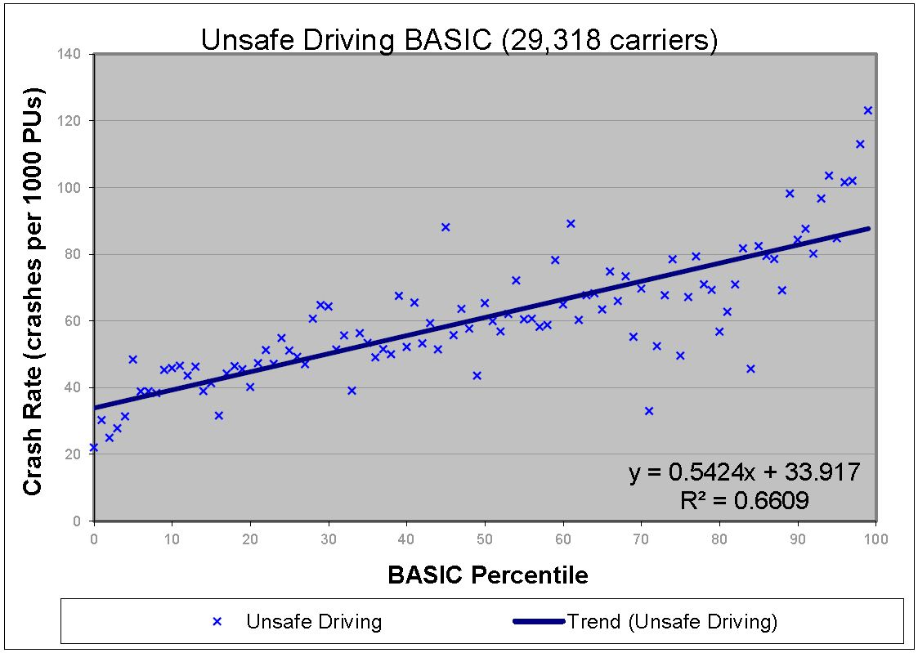
LAW OF LARGE NUMBERS:
SCORES ARE NOT PREDICTORS OF ACTUAL CRASHES
FMCSA REGRESSION OF AVERAGES – UNSAFE DRIVING
UNSAFE DRIVING – PLOT OF 26,435 CARRIERS

Slide 11
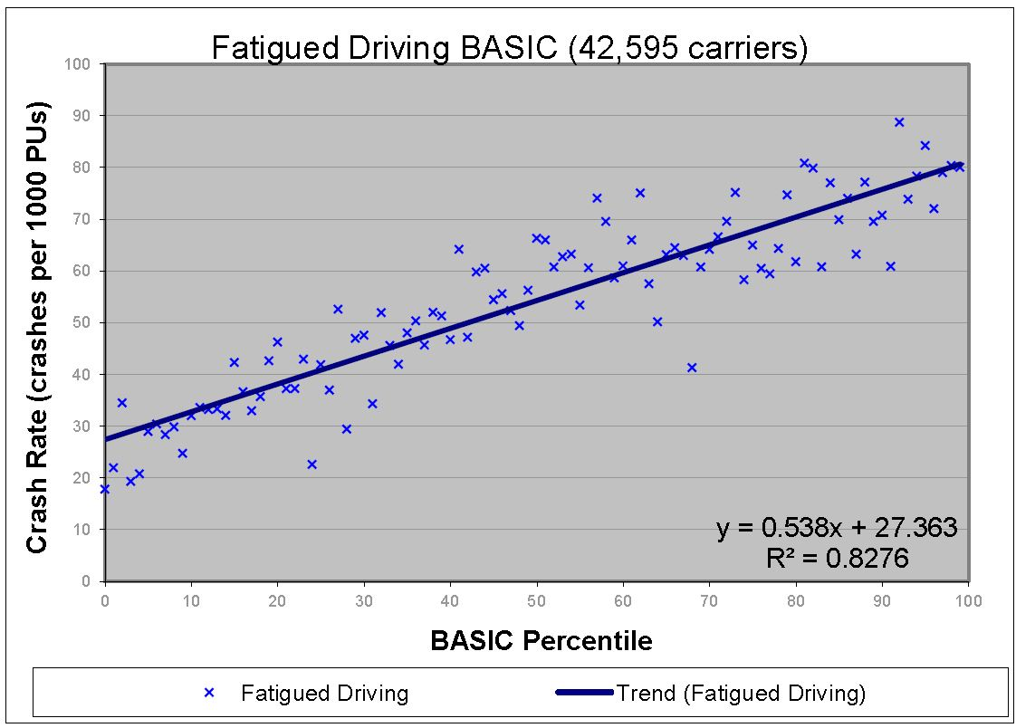
FMCSA REGRESSION OF AVERAGES – FATIGUED DRIVING (HOS)
FATIGUED DRIVING – PLOT OF 35,933 CARRIERS

Slide 12

Crash Ratios and the Law of Large Numbers
10 truck operator involved in 2 non-preventable accidents is over 1.6 million crashes per million threshold.
49% of small carriers with 3
had no accidents in past 2 years.
Proves volatility point, the larger
the size, the less fluctuation.

Slide 13
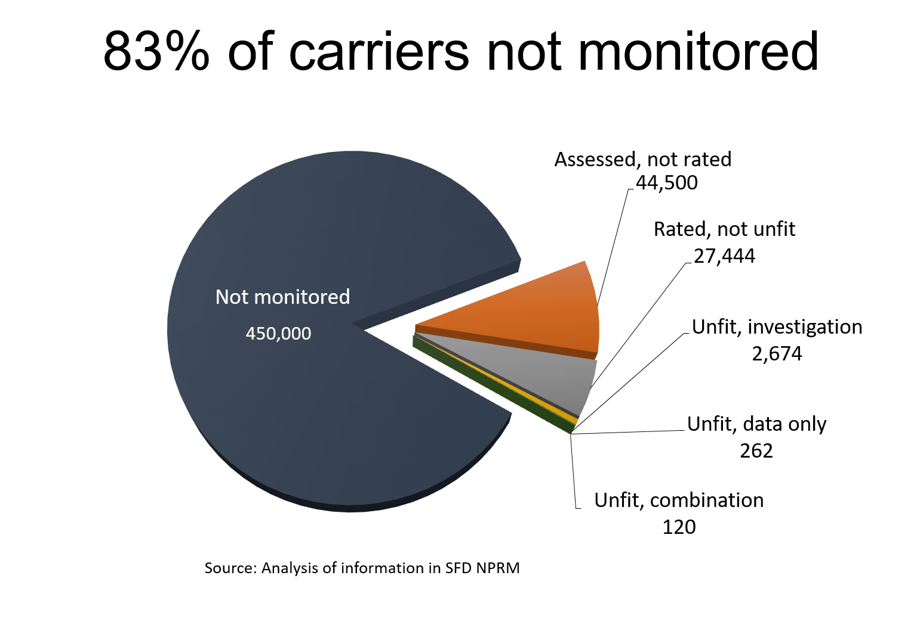

Slide 14
Carriers by number of crashes
Distribution of 211 carriers Agency would have found unfit based on NPRM
Source: FMCSA data through 2016 FOIA request

Slide 15
Fatal Crashes Involving Large Trucks 2013-2018

Slide 16
STICK A FORK IN IT – CSA IS DONE
OIG REPORT MANDATED BY FAST ACT IS IN (9/27/19)
DOT’S OWN INSPECTOR GENERAL FOUND CORRECTION ACTION PLAN:
  LACKS IMPLEMENTATION DETAILS NECESSARY FOR IMPROVING CSA
  CONTAINS NO COST BENCHMARKS OR IMPLEMENTATION DETAILS
  AGENCY DOES NOT PLAN TO COLLECT NEW OR DIFFERENT DATA TO FEED CSA ALGORITHM – NO CHANGES SINCE 2016

Slide 17
IRT – ITEM RESPONSE THEORY
  AGENCY ADMITS IT HAS “LIMITED ABILITY TO FEED NEW DATA INTO THE IRT SCORING SYSTEM”
  OIG FOUND SYSTEM COULD BE PLAGUED BY THE SAME QUESTIONS OF ACCURACY AND CARRIER RATING AS SMS
  OIG NOTES THERE ARE A LIMITED NUMBER OF INDIVIDUALS IN THE U.S. WITH EXPERIENCE IN DEVELOPING LARGE SCALE IRT MODELS (“MATHEMATICAL MAGIC”)
  SEE “REPORT ASKS TOUGH QUESTIONS OF FMCSA’S PLAN TO FIX CSA” JAMES JAILLET, CCJ MAGAZINE 9/27/2019

Slide 18
IRT PROGRAM HAS NOT BEEN PRESENTED.
AGENCY SEEMS TO THINK NO ONE WILL HOLD IT ACCOUNTABLE.
INDUSTRY SEEMS FECKLESS TO DEAL WITH AGENCY’S SHORTCOMINGS.

Slide 19
3. PREVENTABILITY
NO GOOD DEED GOES UNPUNISHED, CALLING BALLS AND STRIKES PROPOSED BY ATA WHEN AGENCY WAS PUBLISHING ALL RECORDABLE ACCIDENTS AND SUGGESTING THAT RECORDABLE ACCIDENT WAS CARRIER’S FAULT.
FIVE YEARS LATER, CSA HAS BEEN DISCREDITED BUT THE AGENCY HAS REPURPOSED PREVENTABILITY.

Slide 20
USING GUIDANCE, IT DEVELOPED AN ARTIFICIAL CONSTRUCT AND A TRIAL PROGRAM TO ALLOW CARRIERS TO CONTEST CRASH PREVENTABILITY.
ATRI FOUND THAT 70% OF THE CRASHES WERE NOT THE CARRIER’S FAULT.
PREVENTABILITY ≠ FAULT ≠ LIABILITY ≠ SYSTEMIC SAFETY FLAWS.

Slide 21
Approximate margin of error 18X
Approximately 85,000 drivers would become toxic by being identified as involved
in a preventable accident for which they were not at fault.

Slide 22
THE PREVIOUS CHART SHOWS WHAT THE AGENCY ADMITS ARE MEASLY RETURNS.
AN ERROR RATE OF OVER 18X.

Slide 23
DUE PROCESS AND PREVENTABILITY
TO WIN A PREVENTABILITY CHALLENGE, A CARRIER MUST MEET THE ARTIFICIAL CONSTRUCT EXCEPTIONS AND OVERCOME A PAR (POLICE ACCIDENT REPORT).
A PAR IS HEARSAY, PRECLUDED FROM ADMISSION IN COURT UNDER 49 U.S.C. §504 BUT IT IS FREQUENTLY ADMITTED.
THE AGENCY HAS REVERSED THE BURDEN OF PROOF AND SAID THAT THE CRASH MUST BE SUCCESSFULLY CONTESTED OR IT WILL BE PUBLISHED AS “PREVENTABLE.”
ENFORCEMENT OFFICIALS NOT IMPARTIAL – JURORS ACT LIKE GRAND JURIES HANDING DOWN INDICTMENTS.

Slide 24
WHY PREVENTABILITY AND GUIDANCE ARE ISSUES WORTH FIGHTING FOR:
IF ALL CRASHES ARE PRESUMED “PREVENTABLE” PLAINTIFF’S BAR WILL HAVE A FIELD DAY.

Slide 25
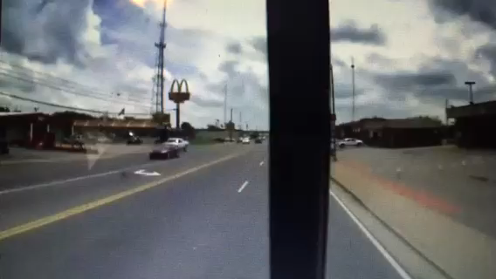
A picture is worth a thousand words

Slide 26
FRONT FACING CAMERA SHOWS EXAMPLE OF HOW MISLEADING PREVENTABILITY CAN BE
CARRIER WAS A BUS COMPANY
RECORDED AS INVOLVED IN FATALITY ACCIDENT
INSURER CANCELED
30 DAYS FOR CANCELATION
FMCSA AND STATE WOULD NOT REMOVE
AGENCY CLAIMS VAST MAJORITY OF RDRS ARE GRANTED BUT DOES NOT COUNT THE APPROXIMATELY 50% IT FAILS TO CONSIDER.

Slide 27
SIMILAR INCIDENTS UNDER “PREVENTABILITY STUDY” RESULT IN THIS TYPICAL AGENCY REJECTION OF RDR SUBMISSION:
“THE CRASH PREVENTABILITY DEMONSTRATION PROGRAM REQUEST FOR DATA REVIEW (RDR) THAT YOU SUBMITTED IS INELIGIBLE FOR PARTICIPATION IN THE PROGRAM BECAUSE THERE IS NO EVIDENCE THE OTHER DRIVER WAS OPERATING UNDER THE INFLUENCE OF DRUGS OR ALCOHOL.”

Slide 28
4. DEEP STATE POLITICS / GUIDANCE MASQUERADING AS RULEMAKING AND DYSFUNCTIONAL POLITICS
AHAA AS PART OF MCRR ASKED THAT PREVENTABILITY BE REVIEWED UNDER APA RULEMAKING AND IN ACCORDANCE WITH THE FAST ACT REQUIREMENTS WHICH WAS DENIED.
ACADEMICS AND CAREER BUREAUCRATS ARE TRUE BELIEVERS IN BIG DATA AND BAD ACTORS WHO HAVE NO OBJECTIVITY.
GUIDANCE OFFERS NO CHECK AGAINST ARBITRARY OR CAPRICIOUS ACTIONS BY BUREAUCRATS.
RULEMAKING PROTECTS RIGHT TO BE HEARD AND BASIS FOR APPEAL.
RULEMAKING IS ESSENTIAL TO REIN IN BUREAUCRATIC OVERREACH.

Slide 29
ISSUES REQUIRED BY RULEMAKING:
    EFFECT ON SMALL BUSINESSES
    COST BENEFIT ANALYSIS
    STATUTORY MANDATE
    REG FLEX / PAPERWORK REDUCTION
    STATUTORY PROHIBITION ON USE
    DUE PROCESS ISSUES, ETC.

Slide 30
SUNK COST THEORY RESULTS IN IGNORING
THERE IS A BETTER ANSWER
NASTC HAS REPEATEDLY SUBMITTED A SIMPLIFIED PROPOSAL TO ASSIGN A SAFETY RATING TO ALL MOTOR CARRIERS.
USING THE NEW CARRIER AUDIT PROCEDURE, THE AGENCY COULD ELIMINATE THE “CONTINUE TO OPERATE” STATUS AND AFFIRM ITS DUTY TO ACTUALLY MAKE A SAFETY FITNESS DETERMINATION ALL CARRIERS COULD RELY UPON.

Slide 31
5. THE FUTURE OF THE INDEPENDENT CONTRACTOR MODEL
IS THE END OF THE INDEPENDENT CONTRACTOR MODEL AT HAND?
THE LEASING REGULATIONS (49 C.F.R. 376) CREATED A TRADITIONAL SAFE HARBOR FOR LEASE OWNER-OPERATORS.
AN ESTIMATED ONE MILLION MORE BLUE COLLAR ENTREPRENEURS OBTAIN SMALL BUSINESSMAN TREATMENT.

Slide 32
UNDER FEDERAL TRANSPORTATION LAW AND THE DOCTRINE OF PREEMPTION, FEDERAL STATUTE SHOULD TRUMP STATE EMPLOYMENT LAW BUT THE COURTS ARE DIVIDED.
IN RECENT YEARS THERE HAS BECOME A PATCHWORK QUILT OF CONFLICTING STATE EMPLOYMENT LAWS AND FEDERAL DEPARTMENT OF LABOR “GUIDANCE” DEPENDING ON THE BUREAUCRAT.
VIRTUALLY EVERY MAJOR TL CARRIER HAS BEEN SUED BY CLASS ACTION PLAINTIFFS CLAIMING HUGE AMOUNTS ARE DUE TO FORMER MISCLASSIFIED OWNER-OPERATORS WHO WERE DENIED WAGES AND BENEFITS DUE THEM AS EMPLOYEES.
BLUE STATES HAVE BEEN TOXIC.
CALIFORNIA IS NOT ALONE – NY, PA, MA, WA ET AL. ARE UNFRIENDLY.

Slide 33
MISCLASSIFICATION ISSUES
AT FEDERAL AND STATE LEVELS
WITHHOLDING
MINIMUM WAGE
WORKER’S COMPENSATION
STATE UNEMPLOYMENT ACT AND STATE TAX WITHHOLDING
CLASS ACTIONS HAVE BEEN BROUGHT AGAINST MANY MAJOR TRUCKLOAD CARRIERS
RESURGENT LABOR INTERESTS ARE LEADING THE CHARGE
BAD FACTS WILL MAKE BAD LAWS - AMAZON

Slide 34
AB5 AND DYNAMEX CASE IN CALIFORNIA MAY BE THE LAST STRAW.
AB5 IS A CALIFORNIA STATUTE WHICH IMPOSES THE ABC TEST ACROSS THE BOARD
CARRIER CANNOT TREAT LEASE OPERATOR AS AN INDEPENDENT CONTRACTOR UNLESS:
  THE CONTRACTOR IS FREE FROM CONTROL OR DIRECTION BY THE CARRIER
  THE CONTRACTOR’S WORK IS PERFORMED OUTSIDE THE SCOPE OF THE HIRING COMPANY’S BUSINESS
  THE LEASE OPERATOR IS ENGAGED IN AN INDEPENDENTLY ESTABLISHED TRADE OR BUSINESS

Slide 35
ESTABLISHING ALTERNATIVE MODELS WILL BE CHALLENGING.
USE OF BROKER OR FREIGHT FORWARDER TO HIRE INDEPENDENT “POWER-ONLY” COMPANIES CAN MEET THE TEST BUT:
  CALIFORNIA LAW EXTENDS TO UBER AND THE GIG ECONOMY WHICH IS WELL WITHIN THE BOUNDARIES IOF THE ABC EXCEPTION
  YET IF THE IC MUST BECOME A CARRIER, BUY WORKER’S COMPENSATION AND LIABILITY INSURANCE, WHAT INCREASE IN RATES MUST BE ABSORBED BY THE CARRIER AND PASSED THROUGH TO THE CUSTOMER?

Slide 36
OTHER ALTERNATIVES
WITHDRAW FROM SERVICING CALIFORNIA ALTOGETHER.
INTERLINE OR CROSS-DOCK FREIGHT IN ARIZONA OR NEVADA
HIRE CALIFORNIA PICKUP AND DELIVERY CARRIERS WHO ABSORB THE COST AND PASS ALONG A CALIFORNIA SURCHARGE
ESTABLISH BROKER OR FREIGHT FORWARDER FOR POWER-ONLY CARRIERS.

Slide 37
REQUIRE EXISTING INDEPENDENT CONTRACTORS TO INCORPORATE AS SUB C OR SUB S CORPORATION WARRANTING COMPLIANCE WITH EMPLOYMENT LAW AND SIGN AS GUARANTOR
  AVOID W-2 AND 1099 TO CALIFORNIA DOMICILES
DRAFT LEASES TO PROVIDE FOR LOAD-BY-LOAD SERVICE
ENSURE THAT LEASED EQUIPMENT IS COVERED WITH DEADHEAD AND BOBTAIL

Slide 38
CONCLUSIONS
ELD AND HOS WILL REDUCE ROADSIDE OUT-OF-SERVICE ORDERS AND PROVIDE SOME NEEDED FLEXIBILITY.
YET FATIGUE AND STRICT ENFORCEMENT STILL UNHINGED BY FATIGUED DRIVING.
SMS DOES NOT WORK AND CANNOT BE REFORMED – IT WAS TERMINATED AND SHOULD BE REPLACED WITH SIMPLIFIED AUDITS AND AFFIRMATION THAT FIT TO OPERATE IS FIT TO USE.
GUIDANCE INSTEAD OF RULEMAKING SHOULD NOT BE PERMITTED.
RULEMAKING IS THE INDUSTRY’S BEST PROTECTION AGAINST DEEP STATE ABUSE.

Slide 39
THE NATURE OF THE OWNER-OPERATOR MODEL IS IN CRISIS. THERE IS NO POLITICAL WILL IN WASHINGTON TO ADDRESS THE ISSUE:
  WE CANNOT EXPECT A SUPREME COURT RULING
  IT IS TOO LATE TO WAIT
  NOW IS THE TIME FOR REVIEW

