Slide 1
FMCSA
Regulatory Update
Auto Haulers Association of America
October 30, 2019
Hilton Head Island, SC

Slide 2
Drug & Alcohol Clearinghouse
HOS Notice
Entry-Level Driver Training (ELDT)
Latest Rulemaking News
Online Resources
SMS

Slide 3

Drug & Alcohol Clearinghouse
Docket No. FMCSA-2011-0031

Slide 4


The Clearinghouse Final Rule
Published December 5, 2016
Mandated by Congress (MAP-21, Section 32402)
Established requirements for the Clearinghouse
Identified January 6, 2020 as the Clearinghouse implementation date
Read the Clearinghouse final rule at:
www.fmcsa.dot.gov/regulations/commercial-drivers-license-drug-and-alcohol-clearinghouse

Slide 5
Tracking Violations: Current Process
Commercial driver’s licenses (CDLs) and commercial learner’s permits (CLPs) holders with drug and alcohol program violations must not operate a commercial motor vehicle (CMV) until they complete required drug and/or alcohol education or treatment.
Current process relies on drivers to inform a new employer of any violations of the drug and alcohol rules committed while with a previous employer.
Motor carriers are required to monitor drivers’ compliance with DOT drug and alcohol regulations.
THIS REQUIRES:
Drivers to self-report positive test results
Motor carriers to conduct and/or respond to background checks and ongoing driver compliance

Slide 6
The FMCSA Commercial Driver’s License Drug and Alcohol Clearinghouse
Database containing CDL drivers’ drug and alcohol program violation information
Reported by employers and Medical Review Officers (e.g., positive tests, refusals, etc.)
Information includes whether a driver has successfully completed the mandatory return-to-duty (RTD) process following a violation
The Clearinghouse will keep driver information secure
Only authorized users, including employers and FMCSA, will be able to register and access the Clearinghouse for designated purposes
Other enforcement agencies, such as SDLAs and State law enforcement agencies, will only receive driver eligibility status
Drivers can access their own information, but not information of other drivers
The Clearinghouse will meet all relevant Federal security standards and FMCSA will verify the effectiveness of security protections regularly

Slide 7

Timeline: Drug & Alcohol Clearinghouse
December 5, 2016
February 2019
October 2019
January 6, 2020
January 6, 2023
Final Rule Published
Requirements, user roles established
Information Phase
Launch of Clearinghouse website
Subscribe for email updates
Registration Opens
Create your user account ahead of Implementation Date
Implementation Date
Mandatory reporting begins
Both electronic and manual queries required
3-Year Post Implementation
Clearinghouse contains 3 years of violation data
Only electronic queries required
7

Slide 8


Who will be required to use the Clearinghouse?
Drivers who hold CDLs or commercial learner’s permits (CLPs)
Employers of CDL drivers who operate CMVs
Consortia/Third-Party Administrations (C/TPAs)
Medical Review Officers (MROs)
Substance Abuse Professionals (SAPs)
State Drivers Licensing Agencies (SDLAs)

Slide 9
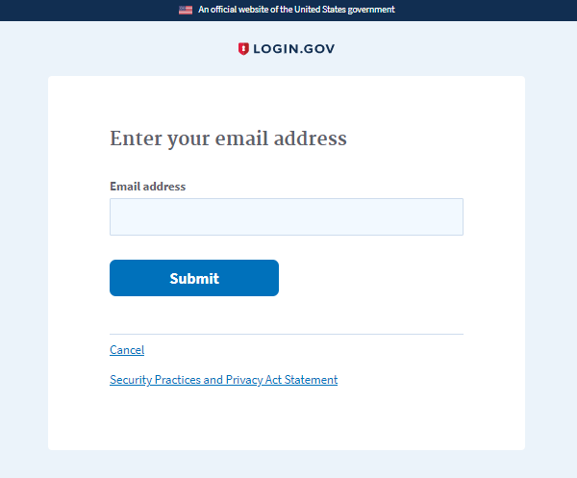
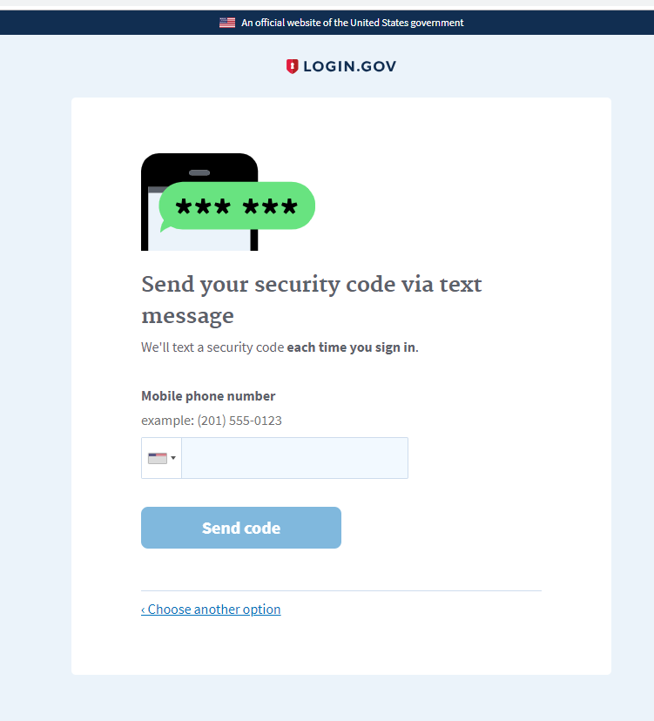
Registration and User Verification
To register and access the Clearinghouse, users must:
  Enter an email address
  for username
  Complete the verification process to protect account

Slide 10
Drivers
Drivers will complete the following actions
in the Clearinghouse:
  REGISTER
  VIEW their information
  PROVIDE or refuse specific electronic consent to an employer for a full query (includes pre-employment queries)
  IDENTIFY a SAP before the SAP can enter return-to-duty (RTD) information about them
Drivers may:
  Submit a petition to correct inaccurately reported information as established in the Clearinghouse final rule and per 49 CFR Part 10
  Request the removal from the Clearinghouse of an employer’s report of actual knowledge of a driver’s traffic citation for operating a CMV under the influence of drugs or alcohol if the citation did not result in a conviction
  Request that other reports of actual knowledge violations, as well as “failure to appear” test refusals, be removed from the Clearinghouse if they were not reported in accordance with §382.705(b)(5)

Slide 11
Employers
Employers will complete the following actions in the Clearinghouse:
  Register
  Report drug and alcohol violations
  Request specific electronic consent from the driver prior to conducting a full query of his or her Clearinghouse record (includes pre-employment queries)
  Designate a C/TPA which allows the C/TPA to enter violation information or conduct queries on the employer’s behalf
  Report a negative return-to-duty (RTD) alcohol and/or controlled substances test result
  Report the completion of a driver’s follow-up testing plan
An EMPLOYER who employs him/herself as a driver (owner-operator) must designate a C/TPA in the Clearinghouse.

Slide 12


Queries
Query Type | Reason for Query | Information Returned | Required Action
LIMITED QUERY | Annual check on currently-employed driver | No records found in the Clearinghouse for queried driver | No action required
 | Ad hoc/periodic check on driver | Records found in the Clearinghouse for queried driver | Full query must be conducted for violation and/or RTD details to be released; if full query is not conducted within 24 hours, driver is removed from safety-sensitive functions, including operating a CMV
FULL QUERY | Pre-employment check on prospective driver Limited query returned records found for queried driver Ad hoc/periodic check on driver | Full violation and/or RTD details for queried driver | If driver has a violation and no negative RTD test result, driver is removed from safety-sensitive functions If driver has a violation and a negative RTD test result, no action required

Slide 13
Consent Requests
Query Type | When is driver consent required? | How is consent provided? | For how long is consent effective? | What action is required?
LIMITED QUERY | Annual check on currently-employed driver Ad hoc/periodic check on driver | Outside the Clearinghouse May be electronic or wet signature Note: FMCSA will provide sample limited consent request form on website | Limited consent form must specify time range | Consent refused Query cannot be conducted Driver removed from safety-sensitive functions Consent provided Retain via paper or electronically in driver’s qualification file Request limited query in the Clearinghouse
FULL QUERY | Pre-employment check on prospective driver Limited query returned information exists for queried driver Ad hoc/ periodic check on driver | Electronically within the Clearinghouse | For each full query for individual driver | Consent refused Employer notified of refused consent Query cannot be conducted Driver cannot perform/removed from safety-sensitive functions Consent provided Query conducted Violation details released, including RTD status If queried driver has violation and no negative RTD test result, driver removed from safety-sensitive functions

Slide 14
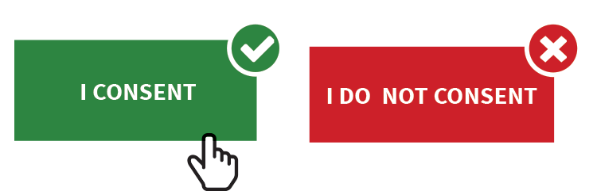
Queries and Consent Requests
REGISTER
Drivers must register
in the Clearinghouse
to provide consent
for full queries (including pre-employment queries)
CONSENT
Employers must obtain
a driver’s specific electronic consent before querying the driver’s violation information
REFUSED CONSENT
Drivers who refuse their consent cannot perform safety-sensitive functions (including operating a CMV) for that employer

Slide 15
Consortia/Third-Party Administrators (C/TPAs)
C/TPAs may:
  ENTER drug and alcohol violation information into the Clearinghouse on behalf of the employer
  REQUEST consent from the driver on behalf of the employer
  QUERY the Clearinghouse on behalf of the employer
  DESIGNATE C/TPA Assistant(s) in the Clearinghouse
Registration Overview:
  C/TPAs will register in the Clearinghouse
  C/TPAs will send an invitation to their Assistants to register in the Clearinghouse
  Registration and login will require users to complete the verification process
The C/TPA must be designated by the employer in the Clearinghouse before the C/TPA can report violation information or query the Clearinghouse on behalf of the employer.
An employer who employs him/herself as a driver (owner-operator) must designate the C/TPA in the Clearinghouse.

Slide 16
Medical Review Officers (MROs)
MROs may:
  WORK for MRO company(ies), or self-employed
  ENTER drug violation information to the Clearinghouse
  DESIGNATE MRO Assistant(s) to enter violation information on their behalf
Registration Overview:
  MROs will register in the Clearinghouse
  MROs will send an invitation to their Assistants to register in the Clearinghouse
  Registration and login will require users to complete the verification process
Notes:
49 CFR Part 40 (section 40.121)

Slide 17
Substance Abuse Professionals (SAPs)
SAPs may:
  WORK for SAP company(ies), or
  self-employed
  ENTER RTD information into the Clearinghouse (date initial assessment completed, date driver eligible for RTD test)
  DESIGNATE SAP Assistant(s) to enter RTD information on their behalf
Registration Overview:
  SAPs will register in the Clearinghouse
  SAPs will send an invitation to their Assistants to register in the Clearinghouse
  Registration and login will require users to complete the verification process
Driver must identify the SAP in the Clearinghouse before the SAP may enter RTD information in the Clearinghouse.
Notes:
49 CFR Part 40 (section 40.121)

Slide 18
C/TPA, MRO, and SAP Assistants
  All Assistants must be invited to register in the Clearinghouse
  C/TPA Assistant enters violation information and queries the Clearinghouse on behalf of the authorized C/TPA; may support multiple C/TPAs
  MRO Assistant enters violation information into the Clearinghouse on behalf of the authorized MRO; may support multiple MROs
  SAP Assistant enters RTD information into the Clearinghouse on behalf of the authorized SAP; may support multiple SAPs

Slide 19
Frequently Asked Questions
Will violations that occurred prior to January 6, 2020, be reported to the Clearinghouse?
  No, only violations that occur on January 6, 2020, or later.
How long is the violation information retained in the Clearinghouse?
  5 years, unless the RTD and follow-up testing is not completed (will be retained indefinitely until follow-up testing is successfully completed).
Will a prospective employee’s drug and alcohol violation history with other DOT modes be available in the Clearinghouse?
  No, the Clearinghouse will contain only drug and alcohol program violation information for employees subject to the testing requirements under the Federal Motor Carrier Safety Regulations in 49 CFR part 382.
Will any information from the Clearinghouse appear in NHTSA’s National Driver Register?
  No.

Slide 20
Frequently Asked Questions
Will every driver need to register in the Clearinghouse?
  No. A driver will only need to register if they need to provide consent to the employer in the Clearinghouse for pre-employment/full queries.
  If a driver is currently with an employer, never incurs a drug or alcohol violation, and never seeks other employment, then the driver does not need to register in the Clearinghouse.
Can an employer register their drivers in the Clearinghouse?
  No. Each individual driver will need to register himself or herself. Registration and login will require users to complete the verification process
Are employers of non-CDL drivers who operate CMVs required to query or report violations to the Clearinghouse?
  No. Only employers who employ drivers subject to Parts 382 and 383 must query or report information to the Clearinghouse.

Slide 21
Frequently Asked Questions
Will employers have the option to submit multiple queries at one time, rather than conduct each query individually?
  Yes. The Clearinghouse will support a feature allowing employers to upload a file containing multiple drivers to be queried; these queries will be conducted in batches. A template of the file to be used for this process will be made available on the Clearinghouse website.
May a consortium/third-party administrator (C/TPA) register an employer for the Clearinghouse on their behalf?
  No. Each user must obtain their own unique login.gov credentials to access the Clearinghouse. For security reasons, a user verification process must be completed to ensure that only the authorized user is using their credentials.
Are there plans to support an employer interface allowing for automated uploads via a web service or similar?
  No. At this time, there are no integration specifications available. Due to FMCSA security requirements and the sensitive nature of driver violation information, employers and C/TPAs must access the Clearinghouse directly. In addition, the Clearinghouse final rule requires FMCSA to record specific consent for the release of the driver’s detailed violation information within the Clearinghouse.

Slide 22

Frequently Asked Questions
What information is the employer required to report?
REPORTING ENTITY | INFORMATION TO BE REPORTED TO CLEARINGHOUSE
Prospective/Current Employer of CDL Driver | An alcohol confirmation test with a concentration of 0.04% or higher.
 | Refusal to test (alcohol) as specified in 49 CFR 40.261.
 | Refusal to test (drug) not requiring a determination by the MRO as specified in 49 CFR 40.191.
 | Actual knowledge, as defined in 49 CFR 382.107, that a driver has used alcohol on duty, used alcohol within four hours of coming on duty, used alcohol prior to post-accident testing, or has used a controlled substance.
 | Negative RTD test results (drug and alcohol testing, as applicable)
 | Completion of follow-up testing.

Slide 23

Frequently Asked Questions
What information is the designated C/TPA required to report on behalf of the employer?
REPORTING ENTITY | INFORMATION TO BE REPORTED TO CLEARINGHOUSE
Service agent acting on behalf of Current Employer of CDL Driver | An alcohol confirmation test with a concentration of 0.04% or higher.
 | Refusal to test (alcohol) as specified in 49 CFR 40.261.
 | Refusal to test (drug) not requiring a determination by the MRO as specified in 49 CFR 40.191.
 | Actual knowledge, as defined in 49 CFR 382.107, that a driver has used alcohol on duty, used alcohol within four hours of coming on duty, used alcohol prior to post-accident testing, or has used a controlled substance.
 | Negative RTD test results (drug and alcohol testing, as applicable)
 | Completion of follow-up testing.

Slide 24
Frequently Asked Questions
Can an employer designate more than one C/TPA?
  Yes.
Who will record positive alcohol results for an owner/operator?
  The designated C/TPA would be responsible to record this violation information regarding the owner/operator they work with.
  An owner/operator may view and query their own information.
  An owner/operator will be required to self-identify as an owner/operator and will be required to designate a C/TPA to access their Clearinghouse account.

Slide 25
Frequently Asked Questions
Will a driver’s follow-up testing plan be available in the Clearinghouse?
  No, follow-up testing plans will not be uploaded into the Clearinghouse.
  When a prospective employee has not completed a follow-up testing plan prescribed by the SAP, the subsequent new employer must continue to obtain the follow-up testing plan from the previous employer, as required in §382.413, and complete the follow-up testing.
Will follow-up testing be tracked within the Clearinghouse?
  No, follow-up testing will not be tracked in the Clearinghouse.
  However, if there is a positive follow-up test result, it must be reported as a new violation.
  The RTD process would be re-initiated after the new violation is entered.

Slide 26
Frequently Asked Questions
How does a driver change or remove inaccurate data?
  The driver may submit a petition via FMCSA’s DataQs system
  FMCSA will review petition and notify driver of decision to remove, retain, or correct information in the Clearinghouse and the reason for decision
  If the driver believes a petition decision was made in error, he/she may submit a request for an Administrative Review
    Request must include an explanation why he/she believes FMCSA made an error in their decision
    Driver informed of decision
    Decision will constitute as the final Agency action
The petition must include:
Petitioner’s contact information
Petitioner’s CDL number and state of issuance
Detailed description why the information is not accurate
What information may be challenged by the driver?
  The accuracy of the information reported
  Report of employer’s actual knowledge the driver received a traffic citation for driving a CMV while under the influence of drugs or alcohol if it did not result in a conviction
  Accuracy of test results and refusals may not be challenged

Slide 27


Frequently Asked Questions
What information is the MRO or SAP required to report?
 | INFORMATION TO BE REPORTED TO CLEARINGHOUSE | DEADLINE FOR REPORTING INFROMATION
MRO | Verified positive, adulterated, or substituted drug test result | Within two business days of making a determination or verification of a DOT-approved drug test
 | Refusal to test (drug) requiring a determination by the MRO as specified in 49 CFR 40.191
 | Changes a verified drug test per 49 CFR Part 40 | Within one business day of making any change in the reported results
SAP | Identification of driver and date the initial assessment was initiated | By the close of the business day following the date of initial assessment
 | Date of determination of eligibility for RTD testing | By the close of the business day following the determination that the driver completed the RTD process

Slide 28
Frequently Asked Questions
Is the driver’s social security number (SSN) or employee identification number (EIN) required when reporting violation information or querying the Clearinghouse?
  No, per §382.123, the employer shall provide the driver’s CDL number and state of issuance
What information is required on the Custody and Control Form (CCF) or Alcohol Testing Form (ATF)?
  The driver’s CDL number and state of issuance must be entered in lieu of the driver’s SSN or EIN
Will FAQs and other outreach materials about the Clearinghouse be updated?
  Yes, our website at https://clearinghouse.fmcsa.dot.gov will be updated regularly with new information, including the factsheet and FAQs. In addition, you will be able to sign up for email updates.

Slide 29

For more information
Visit https://clearinghouse.fmcsa.dot.gov
  Subscribe for email updates
  Read frequently asked questions
  Download the Clearinghouse factsheet
  Download the User Role card
Contact clearinghouse@dot.gov

Slide 30

Registration is Open
Register your company and/or yourself
Designate C/TPA (employers, if applicable)
Set up Assistants (employers, C/TPAs, SAPs, MROs)
Encourage drivers to register

Slide 31


Hours of Service of Drivers
Docket No. FMCSA-2018-0248

Slide 32
Rulemaking Process
August 23, 2018
August 26, 2019
TBD
TBD
Advanced Notice of Proposed Rulemaking (ANPRM)
Document Development
Public Engagement
Comment Solicitation / Analysis
Notice of Proposed Rulemaking (NPRM)
Document Development
Public Engagement
Comment Solicitation / Analysis
Final Rule
Awareness
Implementation
Training
Technical Assistance
32

Slide 33
Background
FMCSA began work on an Advanced Notice of Proposed Rulemaking (ANPRM) in 2018 in response to widespread Congressional, industry, and citizen concerns surrounding existing hours of service (HOS) rules.
The purpose of the ANPRM was to seek feedback from the public to determine if HOS revisions may alleviate unnecessary burdens placed on drivers while maintaining safety on our nation’s highways and roads.
ANPRM was published and open for comment from August 23-October 10, 2018:
  More than 5,000 comments were received
  Considered four areas for revision along with two related petitions
  Used to develop the Notice of Proposed Rulemaking (NPRM)

Slide 34
Goals of the Proposed Rule
The proposed rule on HOS regulations seeks to improve safety by providing additional flexibility for the nation’s CMV drivers.
FMCSA believes this proposal will improve safety by offering the flexibility drivers need to not feel like they must race the clock, needlessly drive through congestion, or have troubles finding parking.
This proposed update to HOS rules is designed to improve safety, but will also provide critical regulatory savings ($270 million) for the American economy.
This rule is only a proposal and an additional comment period is now open. FMCSA strongly encourages everyone to submit their comments to the Federal Register and take part in shaping this critical reform.
GOALS:
Improved Safety
Increased Flexibility

Slide 35
Major Provisions
This proposal would improve efficiency by providing flexibility in five areas:
Short-Haul Operations
Adverse Driving Conditions
30-Minute Break
Split-Sleeper Berth
Split-Duty Provision

Slide 36
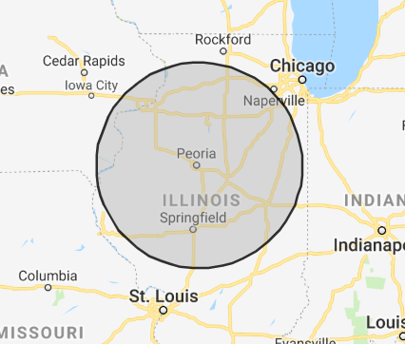
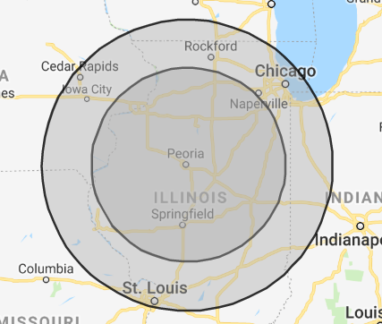
Short-Haul Operations
FMCSA is proposing to change the short-haul exception time period from 12 to 14 hours and extending the distance the driver may operate from 100 air-miles to 150 air-miles.
Example: The driver in this example is based out of Peoria. Under the current rules, the distance the driver could go in a day would not include Chicago or St. Louis. The new proposal would allow that driver to service those two cities, as well as an additional 2 hours.
100 air-mile radius (Current Rule)
150 air-mile radius (Proposed Rule)

Slide 37

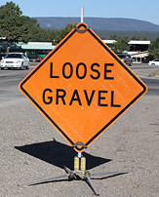
Adverse Driving Conditions
FMCSA is proposing to change the adverse driving conditions exception by extending the duty day by 2 hours. This is in addition to the additional 2 hours of driving time already allowed. The proposed change would apply for both property-carrying (14-hour “driving window”) and passenger-carrying (15-hour on duty) operators.
Example: A driver is 15 miles from his destination when he hears of a gravel spill on the bridge ahead (the bridge is the only access to the destination). He has 1 hour left of driving time and 1 hour left in his “driving window” / duty time. Under the new proposal, this driver can stop at the rest stop at the next exit (for up to 2 hours) to wait for the road clean-up crew to complete work and still have time to get to his destination without violating the HOS rules.

Slide 38
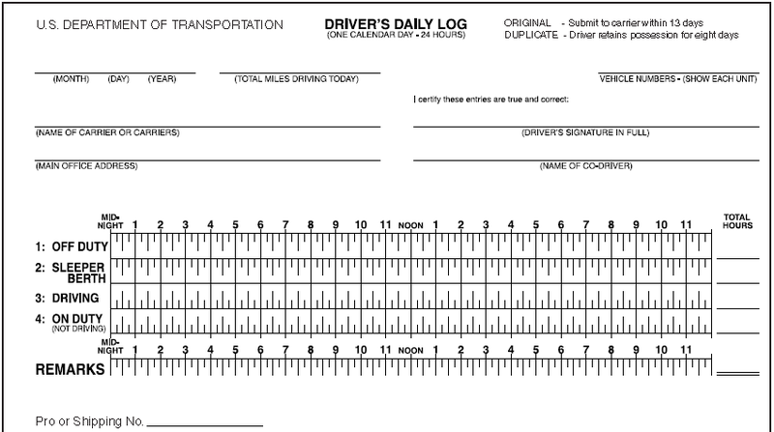

30-Minute Break
FMCSA is proposing to change the 30-minute break rule by allowing the requirement to be satisfied by an on-duty break (in addition to an off-duty break). The requirement for property-carrying drivers would be applicable in situations where a driver has driven for a period of 8 hours without at least a 30-minute interruption.
Example: The examples below assume the driver has driven for 8 hours and needs to take a 30-minute break. Currently, only the log on the left is in compliance with the HOS rules. Under this proposal, both examples are compliant.

Slide 39
Split-Sleeper Berth
FMCSA is proposing to change the sleeper berth exception so that neither part of the split would count against the 14-hour driving window. Drivers would be required to have at least 7 consecutive hours in the sleeper berth and the other period be at least 2 hours off duty (in or out of the sleeper berth) and must total a minimum of 10 hours in the two periods (e.g., 7/3 or 8/2 split).
Example: This example assumes the driver starts day 1 having just come off a 10-hour consecutive off duty period. In this 2-day example, none of the 4 qualifying break periods count against the driver’s 14-hour driving window under this proposal. In this example, the driver uses both a 7/3 split and an 8/2 split to meet the requirements.
3
7
11
3
24
2
8
11
3
24

Slide 40

Split Duty Period
FMCSA is proposing to allow one off-duty break of 30 minutes up to a maximum of 3 hours, that would “pause” a driver’s 14-hour driving window, provided the driver takes 10 consecutive hours off duty at the end of the work shift.
Example: The example assumes the driver has just come off of a 10-hour consecutive break. The driver takes a 3-hour break from 10 am to 1 pm. This break “pauses” the 14-hour driving window. Under this new proposal, as long as the driver takes 3 more hours off duty on the next day between midnight and 3 am to obtain the 10-consecutive hours off duty, the driver will not be in violation of the 14-hour rule using this new provision.
10
0
11
3
24

Slide 41
Focus Questions
FMCSA continues to seek input and data from industry and the public on a number of questions included throughout the NPRM such as the following:
Any comments and/or supporting data on the possibility of a 6 and 4 hour split-sleeper berth break?
What operations would benefit from multiple off duty periods totaling 3 hours?
How often do work shifts require an individual to drive more than 8 hours without at least a 30-minute change in duty status?
Understanding adverse conditions cannot be predicted, will drivers utilize this provision more often after the proposed changes?

Slide 42
Comments
Federal eRulemaking Portal: https://www.regulations.gov
  Enter the Docket Number in the Search box (FMCSA-2018-0248)
  Click on the “Comment Now” button to submit a comment electronically
  Ability to view the full NPRM and other comments submitted
  Comment period has concluded
For Additional Information: https://www.fmcsa.dot.gov/regulations/fmcsa-hours-service-proposed-rule

Slide 43
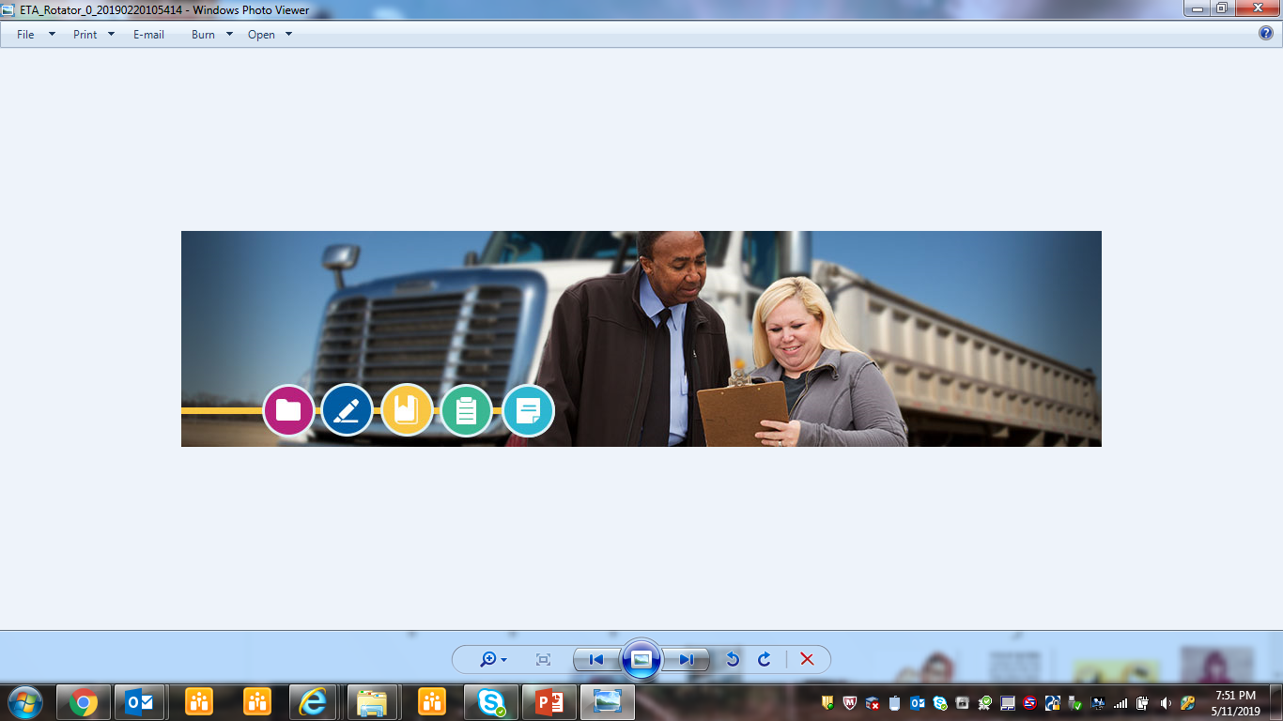
Entry-Level Driver Training (ELDT)
Docket No. FMCSA-2007-27748

Slide 44
The ELDT Final Rule
Published December 8, 2016
Established minimum training requirements for commercial motor vehicle operators
Identified February 7, 2020 * as the ELDT implementation date
Read the ELDT final rule at:
https://www.fmcsa.dot.gov/eldt

Slide 45
Entry-Level Driver Training
Establishes new training standards for individuals applying for:
A Class A or B commercial driver’s license (CDL) for the first time;
An upgrade of their CDL (e.g., a Class B CDL holder seeking a Class A CDL); or,
A hazardous materials (H), passenger (P), or school bus (S) endorsement for the first time.
The rules does not cover individuals for whom States have waived the CDL skills test under 49 CFR 383.

Slide 46
Entry-Level Driver Training
What are CDL applicants required to do?
CDL applicants subject to the rule must complete a prescribed program of instruction presented by an entity listed on FMCSA’s Training Provider Registry (TPR), prior to taking the State-administered CDL skills test, or for the H endorsement, prior to taking the knowledge test
TPR will include all entities (including public and private CDL training programs, fleet-operated CDL training programs, etc.) that register with FMCSA and self-certify they meet the requirements for providing CDL training (minimum criteria for CDL instructors, facilities, curriculum, etc.)

Slide 47
Entry-Level Driver Training
What are types of training will CDL applicants receive?
Class A and B CDL & endorsement curricula subdivided into theory (knowledge) & behind-the-wheel (BTW) (range/public road) segments;
No minimum number of hours that trainees must spend on theory or BTW portion of any curricula;
Training provider must provide instruction in all elements of the applicable theory and BTW curricula and trainees must receive an overall score of at least 80% on assessment (written or electronic).

Slide 48
Entry-Level Driver Training
What happens when the CDL applicants complete the training?
Training providers must transmit electronically the training certification information for each student to FMCSA via the TPR when the student completes the course
FMCSA will transmit electronically the training certification information to the State Driver Licensing Agency (SDLA) as proof the CDL applicant has completed the training prior to taking the State-administered CDL skills test, or for the H endorsement, prior to taking the knowledge test
The SDLAs must modify their IT systems to receive the certification information from FMCSA and to post that information on the applicant’s CDLIS driver record

Slide 49
Entry-Level Driver Training
Training Provider Registry (TPR)
To be eligible for the TPR listing, an entity must:
  follow a curriculum that meets the applicable criteria in Appendices A-E of Part 380;
  utilize facilities meeting §380.709;
  utilize vehicles meeting §380.711;
  utilize instructors meeting §380.713;
  meet recordkeeping requirements §380.725;
  licensed, certified, registered, or authorized to provide training in accordance with the applicable laws and regulations of any State where in-person training is conducted.

Slide 50

Latest Rulemaking
News

Slide 51
Latest Rulemaking News
Crash Preventability Determination Program (Docket No. FMCSA-2014-0177)
  Notice and request for comments published on 8/05/2019; comments due by 10/04/2019
CDL Out-of-State Knowledge Test (Docket No. FMCSA-2018-0332)
  NPRM published on 7/29/2019; comments due by 9/27/2019
HOS: Definition of Agricultural Commodity (Docket No. FMCSA-2018-0348)
  ANPRM published on 7/29/2019; comments due by 9/27/2019
Lifetime Disqualification for Human Trafficking (Docket No. FMCSA-2018-0361)
  Final rule published on 7/23/2019; effective on 9/23/2019
Partial Extension of Compliance Date for ELDT (Docket No. FMCSA-2007-27748)
  NPRM published 7/18/2019; comments due by 8/19/2019
Third Party Commercial Driver’s License Testers (Docket No. FMCSA-2018-0292)
  NPRM published on 7/09/2019; comments due by 9/09/2019

Slide 52
Latest Rulemaking News
Driver Delays Loading and Unloading rulemaking ongoing
  Commenters have reported experiencing delay times of up to 24 hours, and several mentioned that 8-10 hour detention times were not uncommon.
  Despite the availability of technology such as ELDs and GPS devices, most shippers and loaders do not appear to be actively tracking the time a driver has spent there.
  Most commenters feel that detention time should begin after thirty minutes to an hour of waiting.
  Most commenters feel that drivers are not adequately compensated for their time spent waiting during loading and unloading.

Slide 53
Program Briefing
March 2019

Slide 54
Program Timeline
CSA & SMS Launch
2008-2010
FAST Act
December 2015
FMCSA Corrective Action Plan (CAP)
June 2018
FMCSA Correlation Study Launch
June 2018
Looking Ahead
NAS Correlation Study
June 2017
Continuous Improvement: Stakeholder Engagement

Slide 55
NAS Correlation Study
FMCSA commissioned the National Academy of Sciences (NAS) to study CSA and SMS
  Section 5221 of FAST Act
Scope of study included:
  SMS and its Behavior Analysis and Safety Improvement Categories (BASICs)
  Data availability and quality
  Additional recommendations issued prior to FAST Act
NAS held three public meetings to hear input from industry stakeholders, including:
  Carriers
  Government
  Shippers
  Insurance companies
  Safety advocates

Slide 56
NAS Report: Overall Findings
SMS is sound, defensible, and structured in a reasonable way
SMS uses sensible approach based on crash prevention rather than prediction
FMCSA should explore more statistically principled approach to prioritizing carriers for intervention
FMCSA should focus on improving the data that goes into its prioritization process
Rolled up into six recommendations for Agency’s consideration

Slide 57
NAS Recommendations
1
2
Improve quality of MCMIS data
3
4
5
6
Collect additional data
Make more user-friendly technical resources available to public
Conduct additional study to better understand if percentiles should be publicly available
Use absolute and relative measures to prioritize carriers for intervention
Develop and test an Item Response Theory (IRT) model for carrier safety

Slide 58
FMCSA Corrective Action Plan (CAP)
CSA & SMS Launch
2008-2010
FAST Act
December 2015
FMCSA CAP
June 2018
FMCSA Correlation Study Launch
June 2018
Looking Ahead
NAS Correlation Study
June 2017

Slide 59
FMCSA CAP
Outlines steps Agency will take to address six NAS recommendations
Informed by stakeholder feedback gathered via:
  Federal Register Notice on NAS Report
  Public Meeting (September 8, 2017)
Available for review on FMCSA’s website

Slide 60

Online Resources

Slide 61
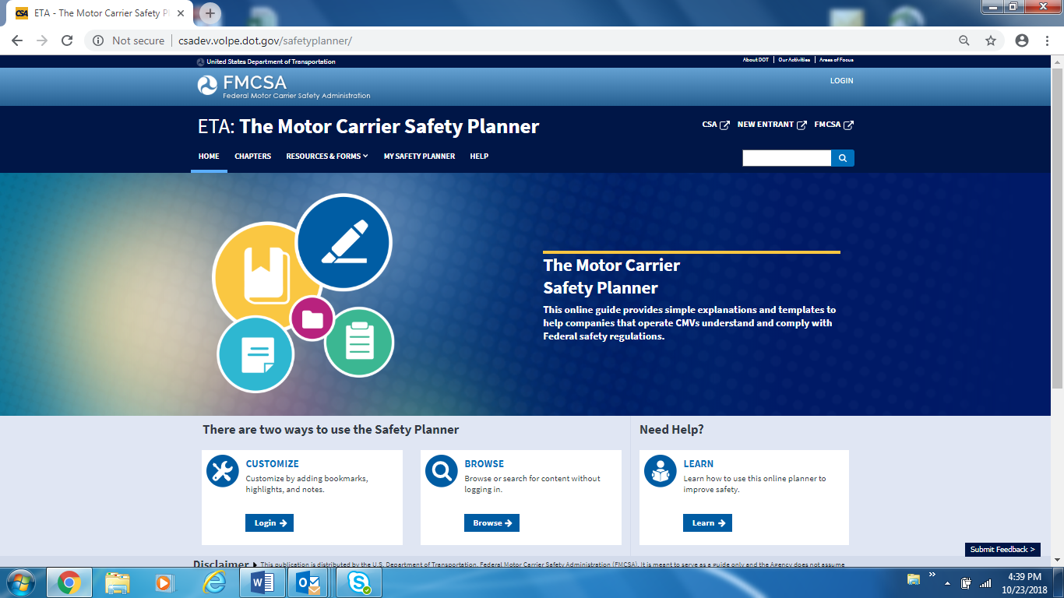
The Motor Carrier Safety Planner
Website: https://csa.fmcsa.dot.gov/safetyplanner
With an FMCSA Portal account, create personalized versions of the Motor Carrier Safety Planner with your own bookmarks, highlights, and notes.
Watch the Customizing a Safety Planner video tutorial on the Help page to learn how to build your own planner.

Slide 62
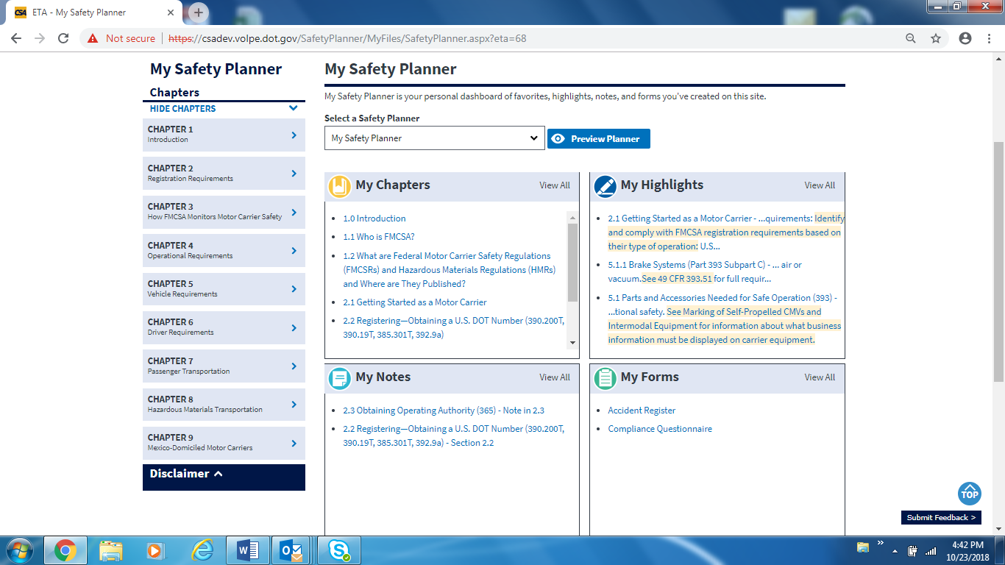
The Motor Carrier Safety Planner

Slide 63
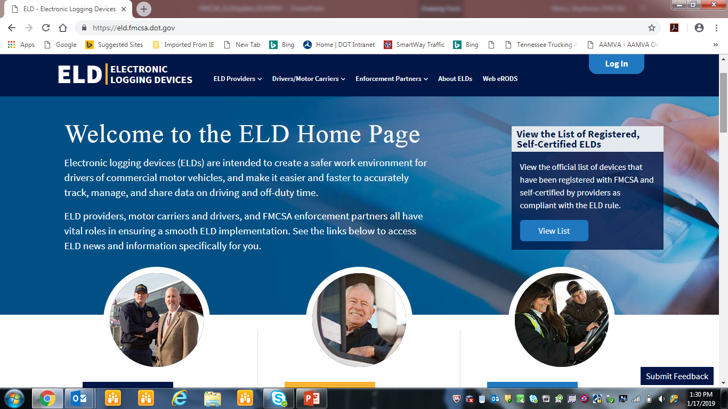
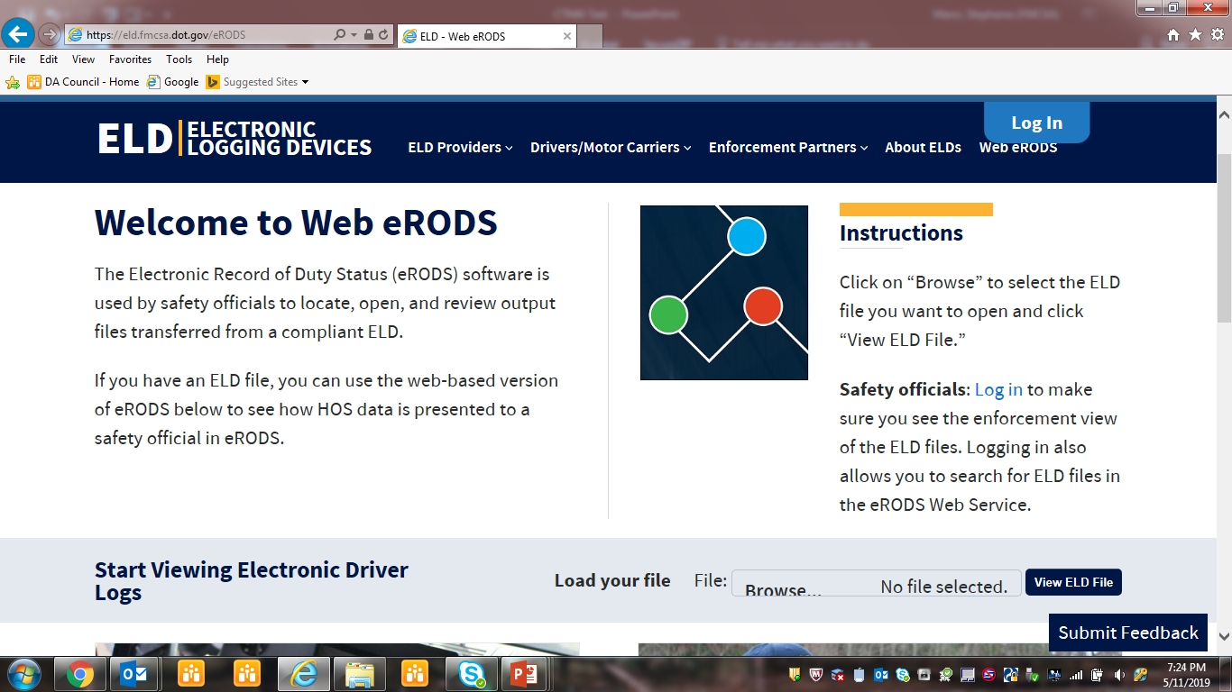
Electronic Logging Device (ELD) Home Page and Web eRODS
Website: https://eld.fmcsa.dot.gov/
E-mail for ELD Program Office: ELD@dot.gov
E-mail for ELD Malfunction Extension Request: ELD-Extension@dot.gov

Slide 64
Thank you!
For questions not answered in today’s presentation:
Jon R. McCormick
FMCSA North Carolina Division Administrator
Telephone: 919-256-9672
E-mail: jon.mccormick@dot.gov
Website: www.fmcsa.dot.gov

