Slide 1
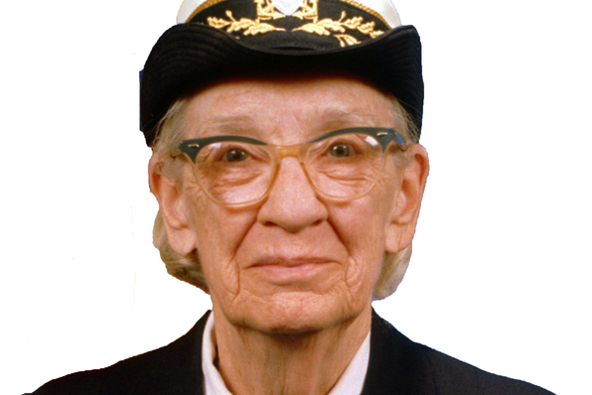
Notes:
Anyone know who this is?
I served 10 years in the Marine Corp so I became familiar with her accomplishments and work ethic
She coined a phrase...

Slide 2
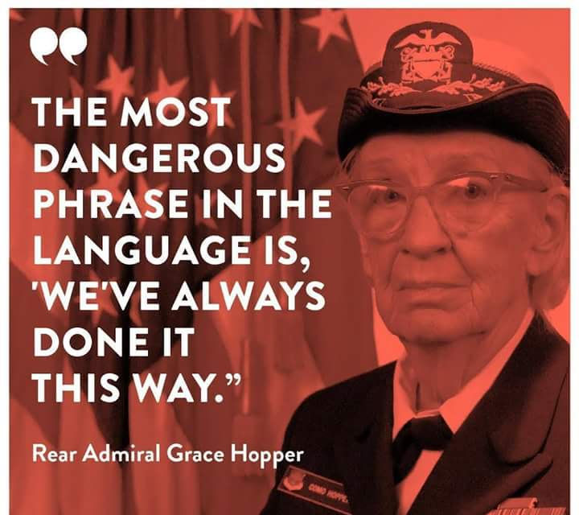
Notes:
There are a few guys in this room who live by this phrase too.

Slide 3

Data exchange
An AHAA supported initiative to help carriers do better business
Derric Hicks - Car Delivery Network
Notes:
And we met with them in Feb2019 to build an industry wide data exchange that would eliminate many of the issues with subcontracting
Centurion, Hansen & Adkins, USAL, Jack Cooper and CDN met in Kansas City to set a standard that would enable these companies to exchange loads and data electronically

Slide 4
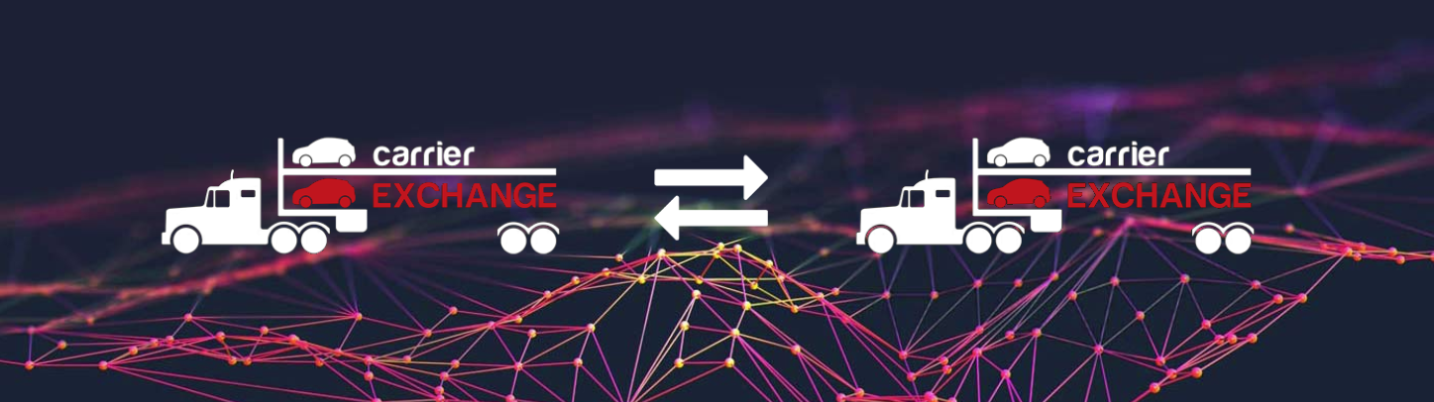
What is it?
A simple Carrier to Carrier interface that allows both carriers to use their own TMS, native ePoD and in-house business processes to subcontract the delivery of vehicles while maintaining customer compliance.
A network of connected OEM Carriers and small subcontracting carriers
Notes:
After full day of discussions we had agreed the basic standard file format that enabled…

Slide 5
Why do we need a Data exchange?
It makes good business sense
ePod has changed the way we communicate with our drivers
New systems and processes have been implemented to support ePoD deliveries
We subcontract loads to Carriers aiding in capacity and profitability
The subcontracting processes are different from the “company driver” process
We don’t all use the same TMS or ePoD systems
It’s prohibiting and complex to train our Drivers or Logistics teams to use multiple “systems”
Notes:
We have gone from paper dispatch to electronic dispatch via ePOD
Due to ePOD, Now many of us run 2 business processes. 1) paper for subcontracting 2) electronic for company drivers
We are having to train our drivers to use other ePOD solutions they aren’t familiar with or we don’t accept the load because we aren’t going to put another app on our tablet/phone

Slide 6
Why do you need a Data exchange?
We must remain OEM data compliant to retain our freight contracts
We need to meet contract obligations and avoid having to give freight back
We need better visibility and control over our small subcontractors
Small Carriers need to remain compliant to the OEM requirements for large carriers
Notes:
When you subhaul a load to either a small or large carrier many manual processes are involved that impede customer compliance
You also lose visibility when subcontracting compared to when you use company drivers

Slide 7
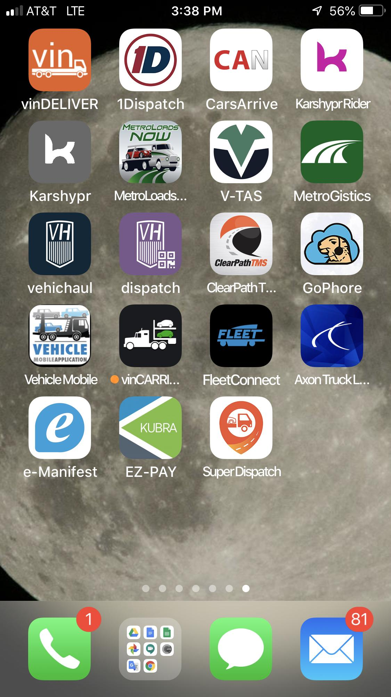
What if we don’t exchange data electronically?
We will continue to “fall over” on customer compliance
Shippers tell us what “app” to use to deliver their vehicles
Our drivers end up with 15 “apps” on their device like in the used car space
We will continue to carry the cost and complexity of multiple processes
We face OEM mandate of their own version of this
We will put our freight contracts at risk and lose control over our ramps if we don't have adequate capacity
Notes:
If you subcontract loads and your honest, you are failing to meet customer requirements on subhauled loads and they are affecting your scores
Your drivers are having to use apps they’re not familiar with
It’s a prohibitive and burdensome on the drivers, they don’t use it properly or at all
If you don’t have something in place the OEM will likely mandate it’s own version
New capacity opportunities are gained when carriers are willing to exchange freight peace of mind knowing they can use their own app, delivery will trigger automatically, no manual data entry

Slide 8
Who is involved?
Connected
USAL
Centurion
Harbor
500+ small carriers active
...
Connecting
Hansen & Adkins
Supreme
Jack Cooper
Sierra Mountain
30+ ATLinks Carriers
Loadrpm
Enabled Software
Car Delivery Network
ATLinks
TMW
ClearPath

Slide 9
The Benefits from a Carrier Exchange
Reduce double-entry of data
The load data is electronically transmitted directly into your TMS
Saves Time and Money
Gain additional backhaul opportunities through a trusted network of connected carriers
Office personnel will receive all load status updates electronically
They’re freed up to manage your freight, drivers and service customers instead of chasing paperwork, redundant data entry and lost hours on emails and phone calls.
Notes:
All data is electronic - vin data, status updates, delivery data, signatures, damage photos, AIAG damage codes

Slide 10
The Benefits from a Carrier Exchange
Drivers learn 1 ePoD app
Driver’s will no longer be required to download multiple apps to complete loads.
Provides you with higher ePOD compliance scores and delivery times
Saves time on-boarding and training new drivers
OEM & customer requirements
Your TMS is able to send real-time delivery data for sub-hauled loads
Provides a trusted network for additional capacity that is connected electronically
Notes:
Your ePOD compliance increases because the sub-haul driver is able to use the app he prefers or is native to his company.

Slide 11
How do I get connected?
Encourage your carrier trade partners to get connected
Encourage your TMS provider to connect
Call CDN to get connected
Talk to Car Delivery Network if your TMS is an “in house” system or you use vinDELIVER for your ePoD
Notes:
Obviously you can reach out to us. But if you are asking your carriers and vendors to connect. The customer/vendor request is far stronger
SME gave me a list of carriers and 3PL’s they want to get connected

Slide 12
QUESTIONS ?
An AHAA supported initiative to help carriers do better business
Derric Hicks - Car Delivery Network
derric.hicks@cardeliverynetwork.com
817 538 7553

