Slide 1
Economic & Trucking Update
October 2019
Alan Karickhoff
Research Analyst
akarickhoff@trucking.org

Slide 2
Economic Forecast Highlights:
Continued growth for the U.S. economy, but at a slightly slower rate than in 2018.
Prospects of a recession in 2019 and 2020 are low.
Excluding trade war escalating, back to trend growth, or slightly better, through 2020.
Consumer fundamentals are good, including a solid job market, but retail sales growth slows this year.
Housing starts continue to disappoint – flattish to down slightly in 2019 and 2020 – but at high levels.
Manufacturing activity grows this year, but at a slower rate.
High level of inventories is currently hurting truck freight – it’s related to trade flows.
Inflation is low, but there are pockets of more rapid increases.
Fed lowered target range for the federal funds rate to 2% – 2.25% July 31, 2019.
  1.75% - 2% September 18, 2019

Slide 3
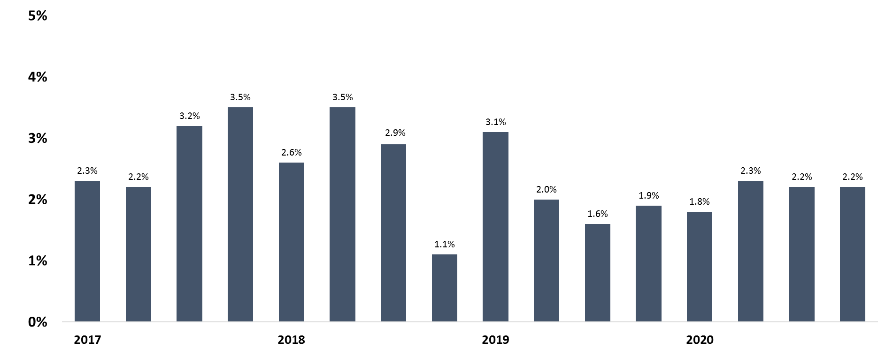
Real Gross Domestic Product Growth
Annualized Rates
Forecasts
Trend growth is roughly 2%
Sources: BEA & ATA
Cannot average to get annual number.

Slide 4
Drivers of Truck Freight

Slide 5
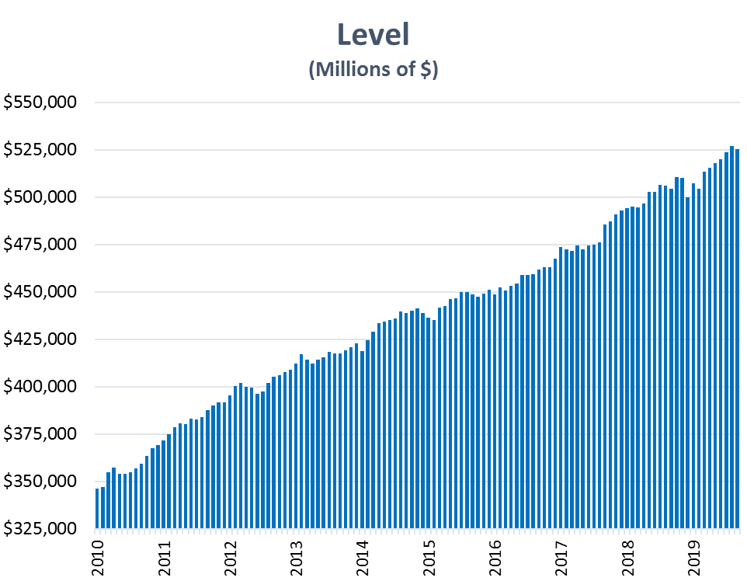
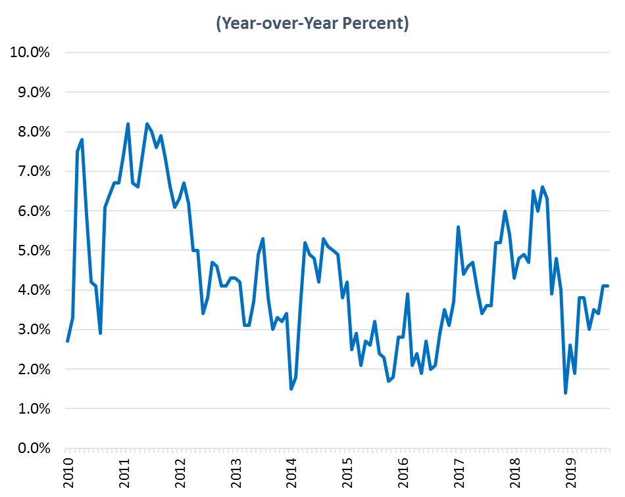
Retail Sales
 | Avg 2010-15 | 2016 | 2017 | 2018 | 2019
Sales Growth | 4.7% | 2.9% | 4.7% | 4.9% | 3.0%
Sources: Census Bureau & ATA

Slide 6
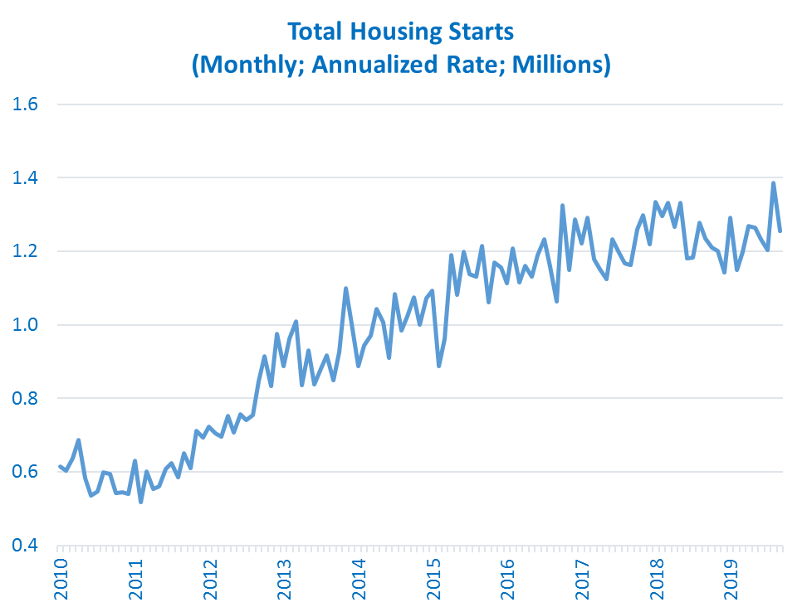
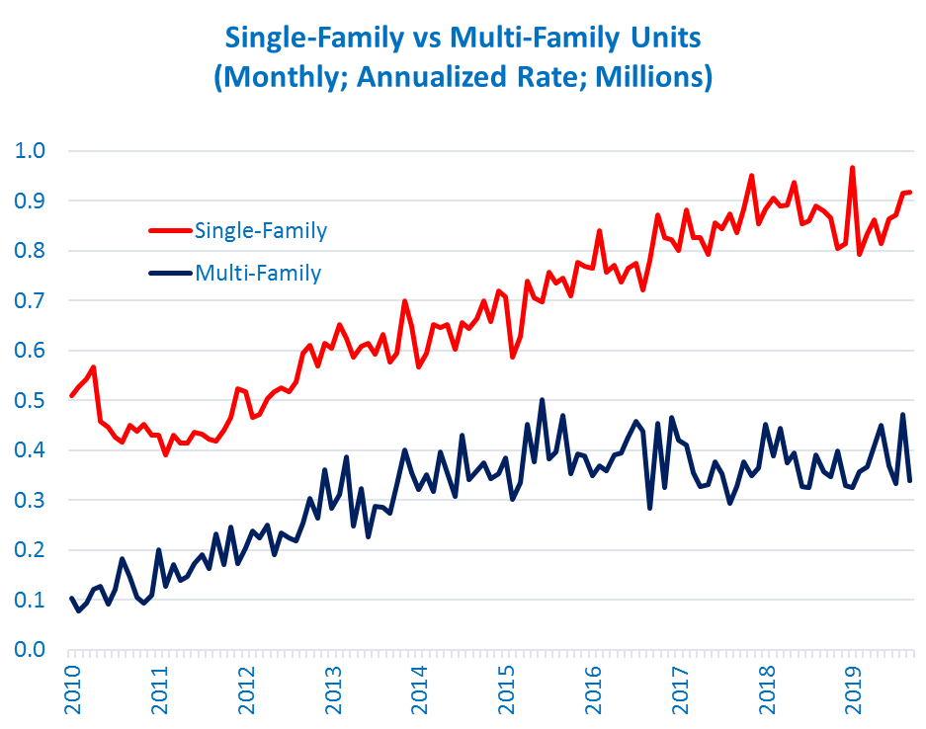
Housing Starts are Leveling Off
 | 2016 | 2017 | 2018 | 2019 | 2020
H.S. | 1.18 M | 1.21 M | 1.25 M | 1.24 M | 1.23 M
Sources: Census & ATA

Slide 7
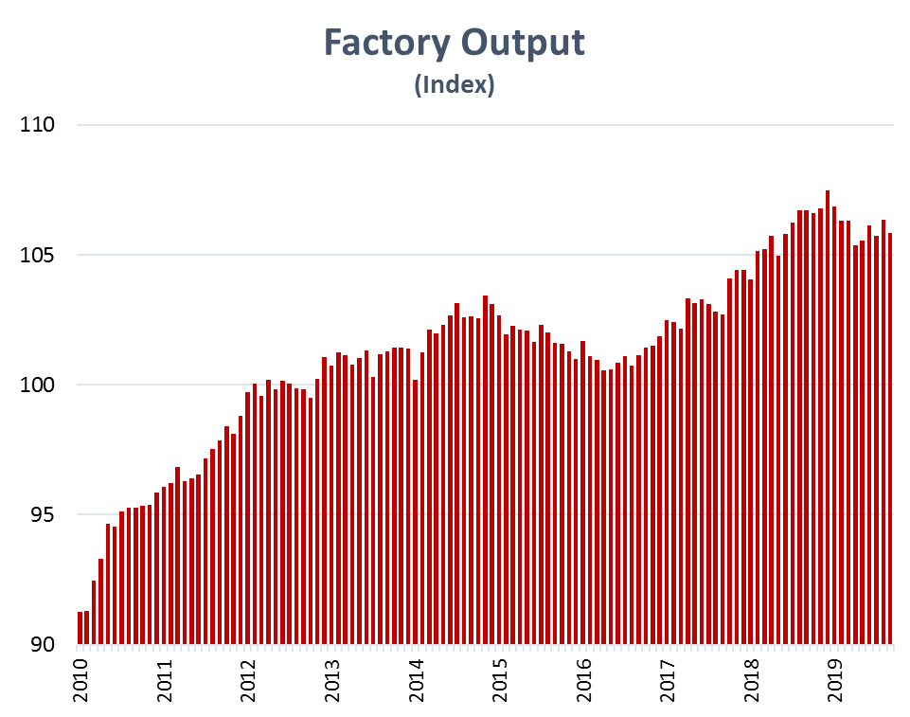
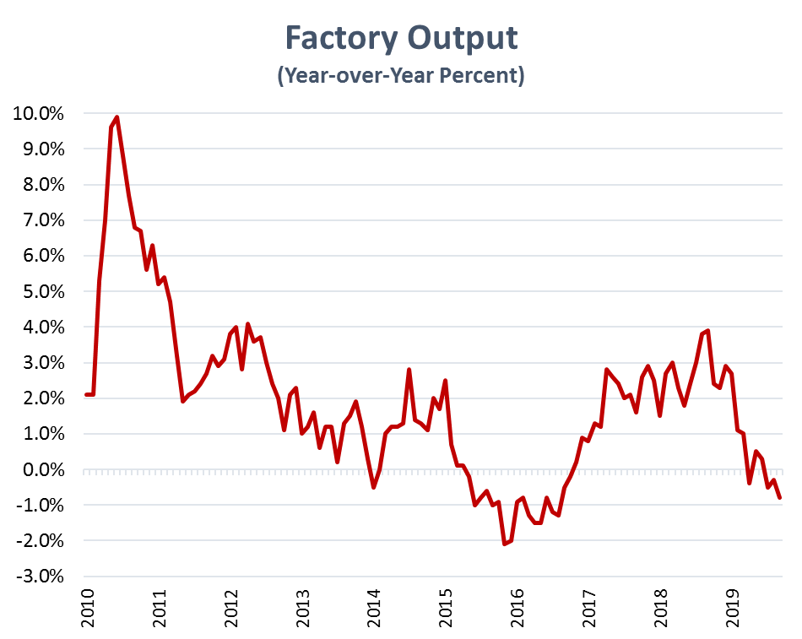
Factory Output
 | 2016 | 2017 | 2018 | 2019
Output | -0.7% | 2.0% | 2.7% | 0.1%
Sources: Federal Reserve & ATA
Notes:
We don’t have a Manufacturing PMI slide here, but the US is hovering just above 50, while the Euro area fell below 50 at the beginning of this year

Slide 8
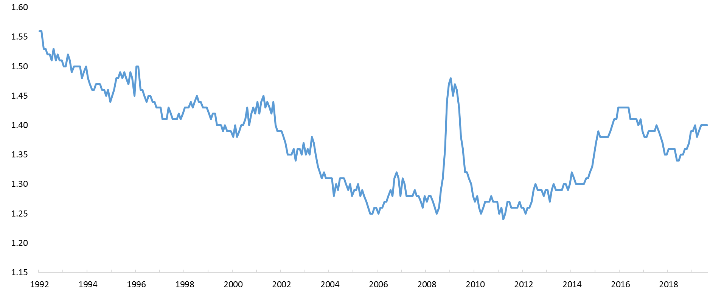
Total Business Inventory-to-Sales Ratio
(Data adjusted for seasonal, holiday, and trading-day differences, but not price changes)
Likely Optimal Range
Source: Census Bureau

Slide 9
Trade Policy Update

Slide 10
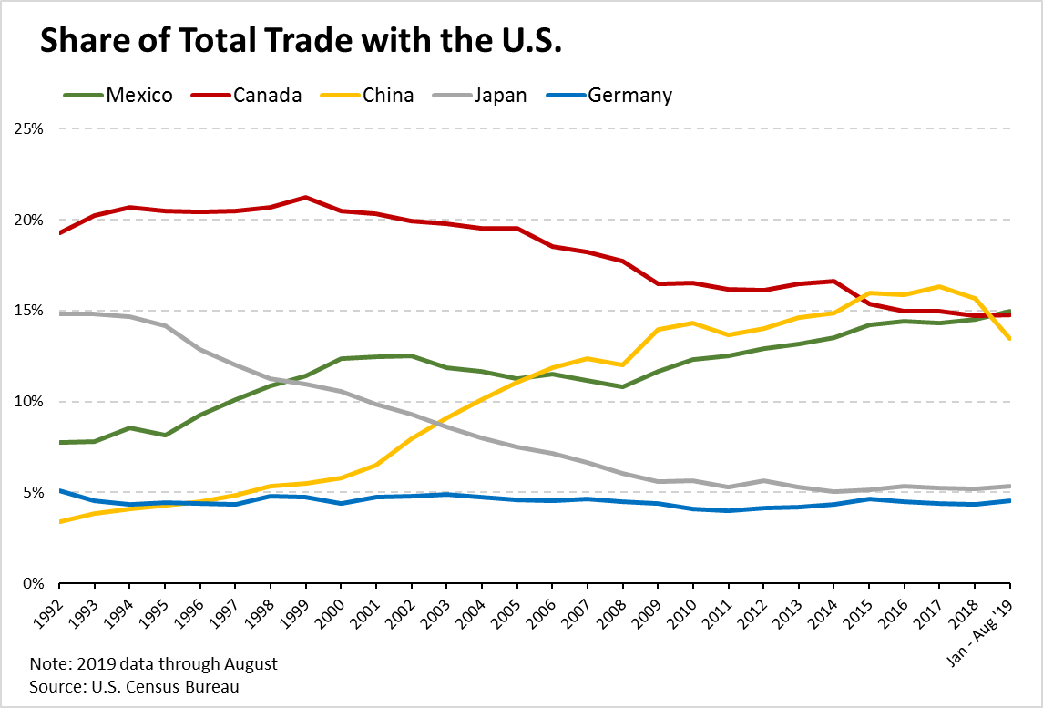

Slide 11
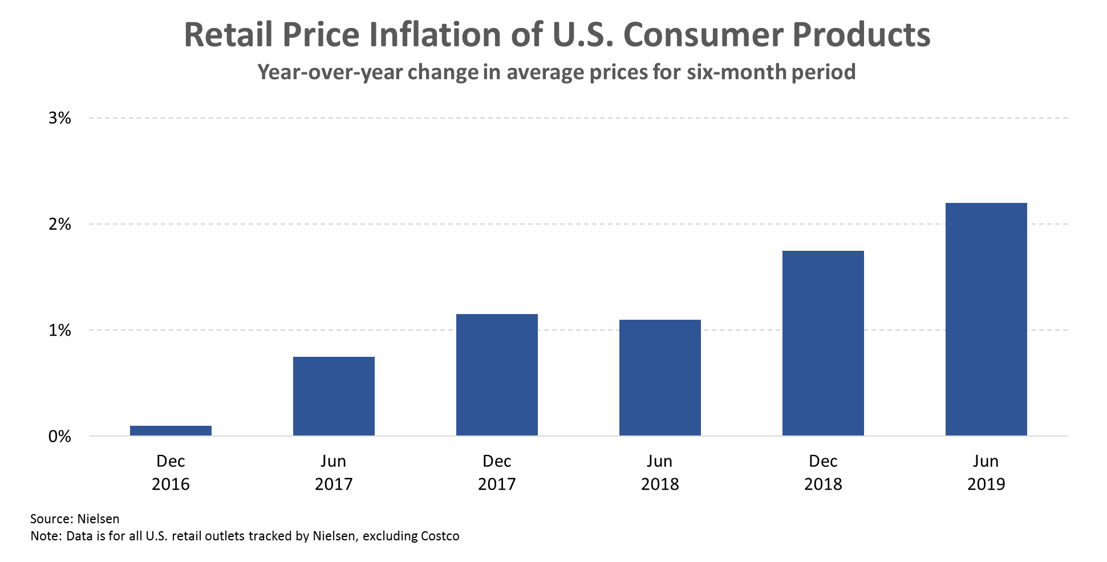

Slide 12
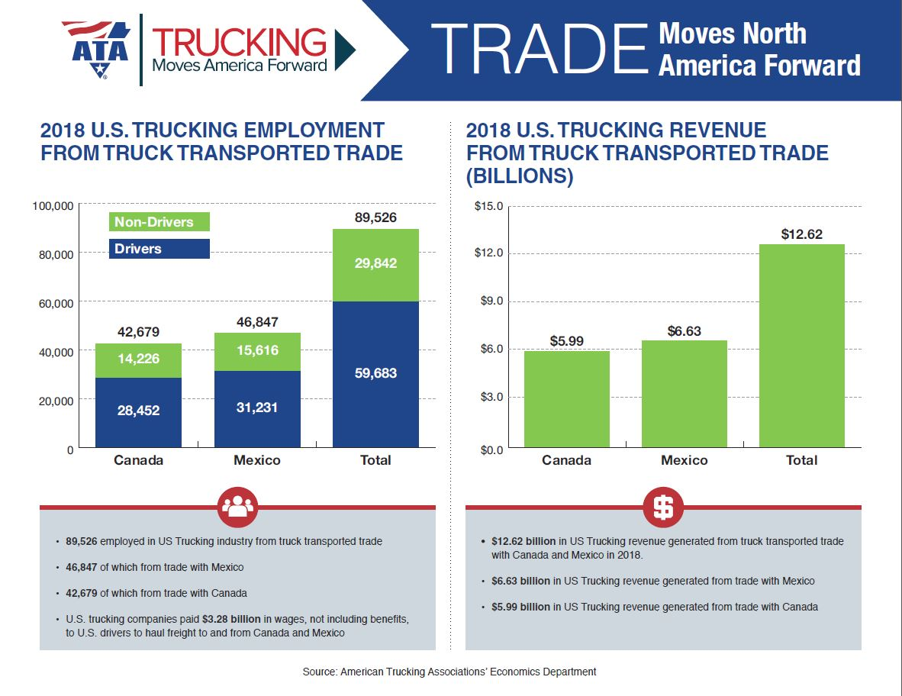
USMCA Update

Slide 13
Trucking Trends

Slide 14
Trucking Trends:
Contract freight fundamentals are ok, not great like in 2018.
TL Contract freight is doing significantly better than the spot market. Any “Freight Recession” is due entirely to spot market.
Focus needs to be on level of freight, not growth rates – a little bit of growth or decrease on high volumes is still good.
LTL freight market is soft, but might be bottoming out.
There has been some capacity additions from several sources – enough to inflict pain on motor carriers.
  It appears that there were some new, small entrants into the industry;
  and, some shipper efficiencies likely added effective capacity.
Drivers market remains tight(ish), but large pay increases and media attention helped.
Notes:
Both were in agreement on IMO 2020 regulation. The capping of sulfur content in marine fuels will likely increase demand for distillate fuel and raise the price of diesel, but neither believe this will have any real impact on TL capacity. It will likely provide a fuel cost headwind for TL carriers, but not necessarily a meaningful catalyst to leave the industry.

Slide 15
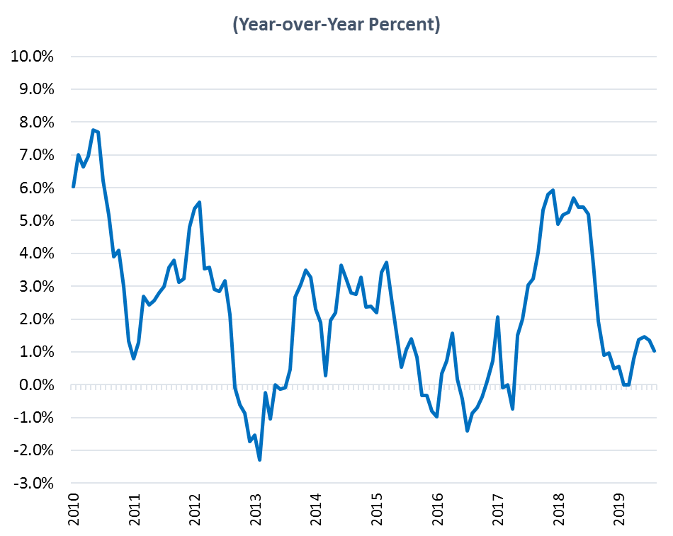
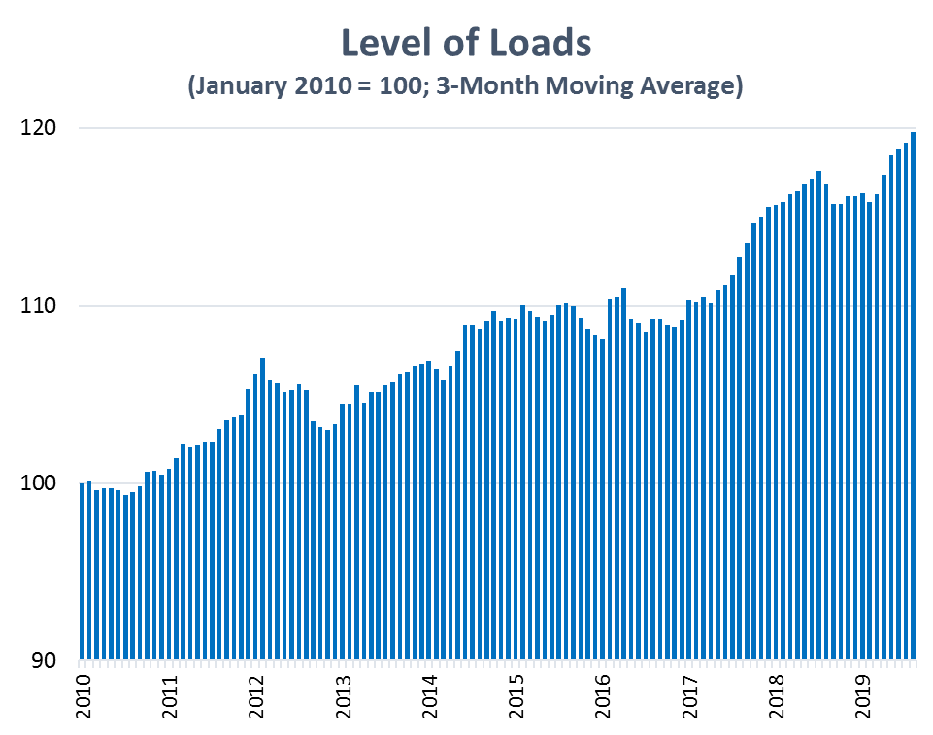
Total For-Hire TL Loads
(3-Month Moving Average Data)
Includes Dry Van, Flatbed, Temp Controlled, and Tank Truck
Primarily contract freight; includes very little spot market freight
 | Avg 1993-2018 | 2016 | 2017 | 2018 | 2019 Forecast
Loads Growth | 1.9% | 0.1% | 3.0% | 3.2% | 1.5%
Source: ATA’s Trucking Activity Report

Slide 16
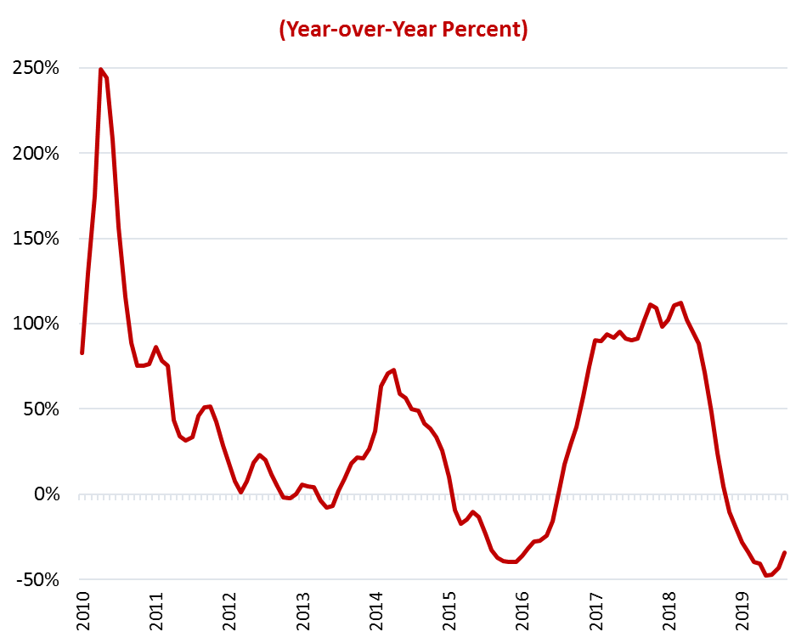
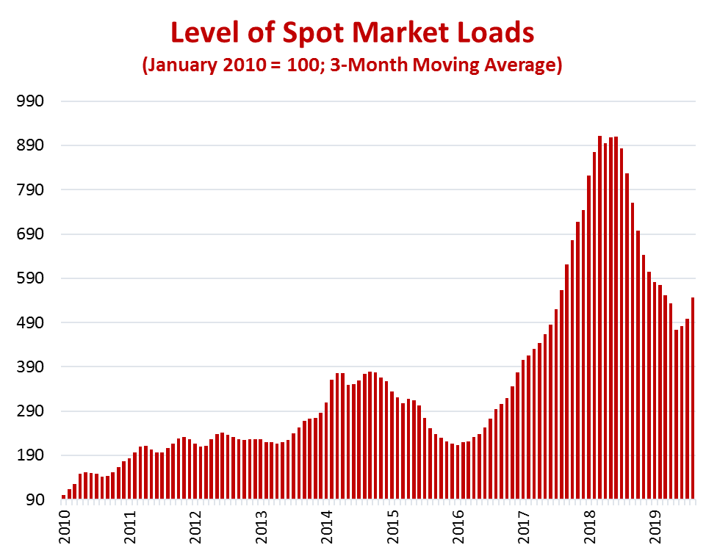
Spot Market Loads
(3-Month Moving Average Data)
Sources: DAT.com and ATA

Slide 17
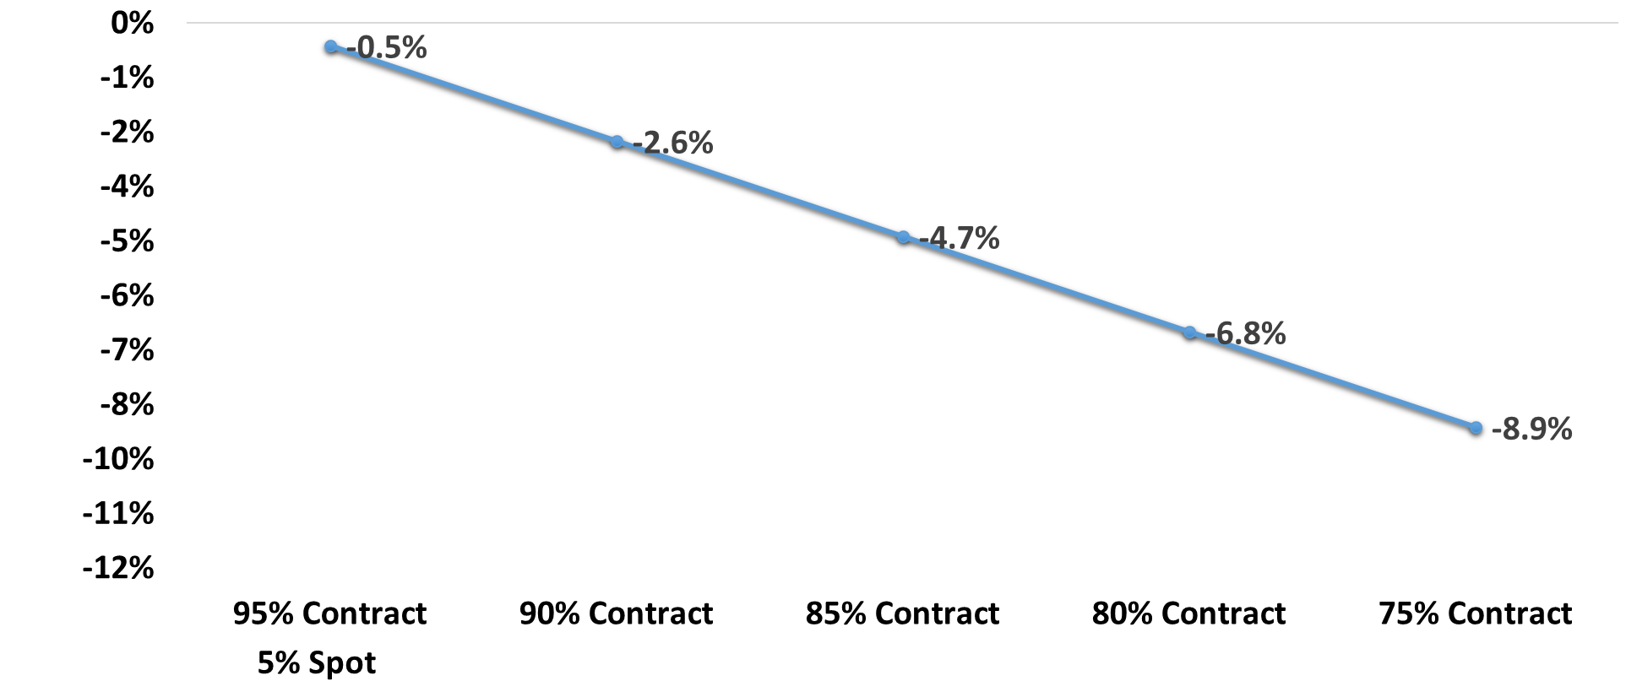
Year-to-date 2019 Truckload Volumes
Year-over-Year Changes
Any 2019 “Freight Recession” magnitude depends on the relative size of the spot market. Contract freight is up 1.6% in YTD year-over-year, on difficult comparisons. Spot market is off 40%.
Corresponding Decrease in Total TL Volumes
10% Spot
15% Spot
20% Spot
25% Spot
Possible Relative Sizes of Contract & Spot Markets
Source: ATA’s Economics Department

Slide 18
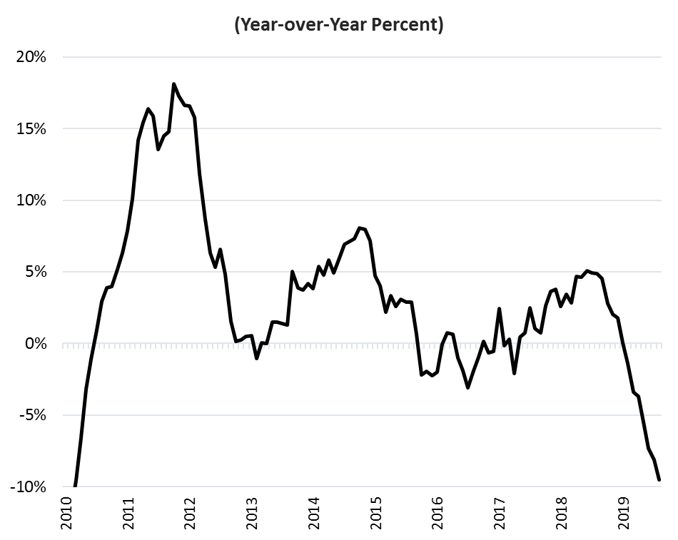
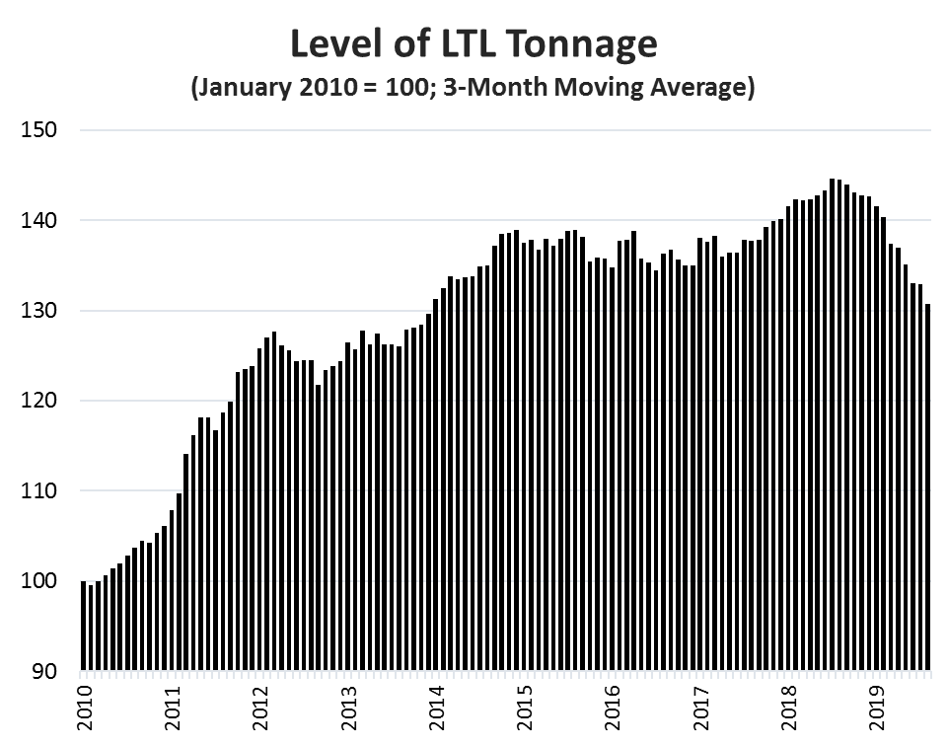
LTL Tonnage
Source: ATA’s Trucking Activity Report

Slide 19
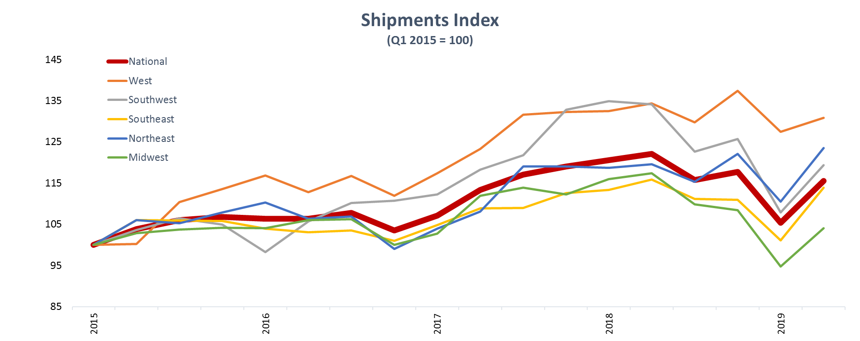
US Bank Regional Data
Source: US Bank https://freight.usbank.com Includes TL and LTL Truck Freight; Contract & Spot

Slide 20
Industry Capacity Trends
Notes:
Supply impact will vary - and we believe the net effect is less capacity
HOS rule changes - proposed changes include a) eliminating the mandatory 30-minute break, b) splitting the sleeper berth requirement from one eight-hour period into two periods, and c) adding a three-hour rest break that stops the on-duty clock. The areas proposed don't allow drivers to drive more hours in a day. • timing of impact - 2Q20 at earliest
Conversion of AOBRs to ELDs - when the ELD mandate came down December 18, 2017, many carriers already had electronic log books, although they were non-compliant. Because they were already off paper logs, they were awarded a two-year grace period to convert to a compliant ELD. Some estimate that as many as half the electronic logs are still AOBRs. While we think it's less than that now, and some of them are exempt from the new rules anyway, it remains significant and likely to be a net negative for capacity when fully converted to ELDs. • timing of impact - late December 2019

Slide 21
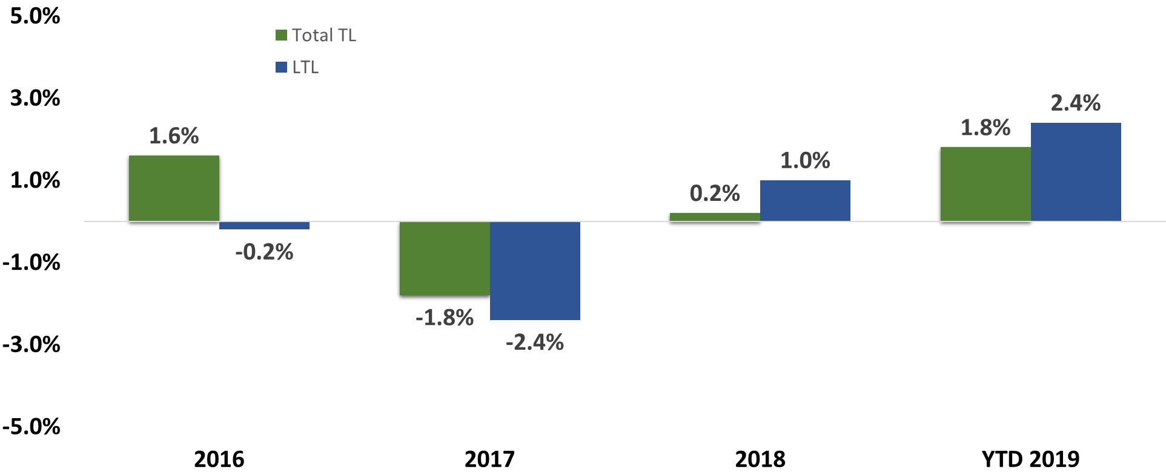
For-Hire Net Tractor Changes
Year-over-Year Changes
Source: ATA’s Trucking Activity Report
Includes company and independent contractor equipment

Slide 22
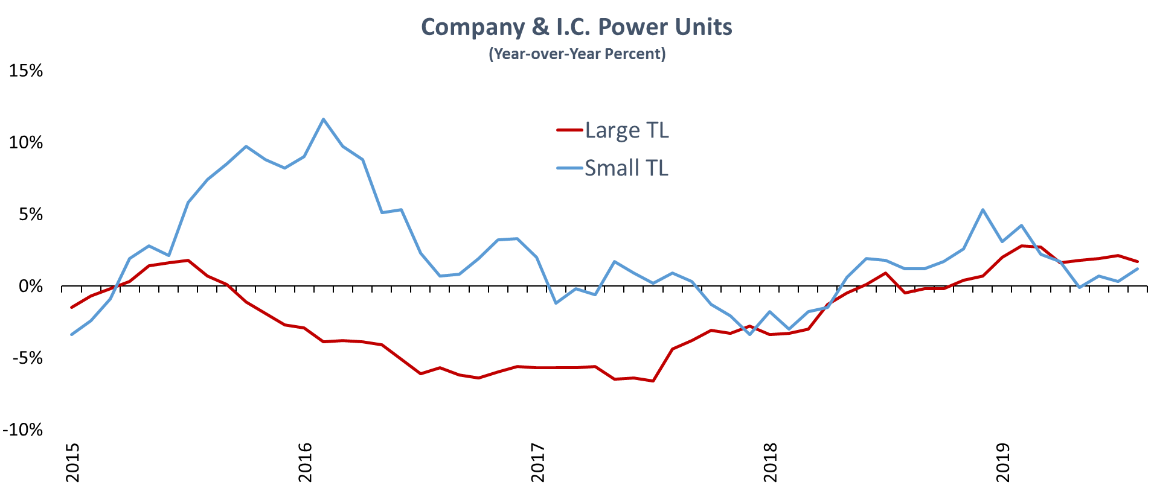
For-Hire Truckload Tractor Data
Source: ATA’s Trucking Activity Report

Slide 23
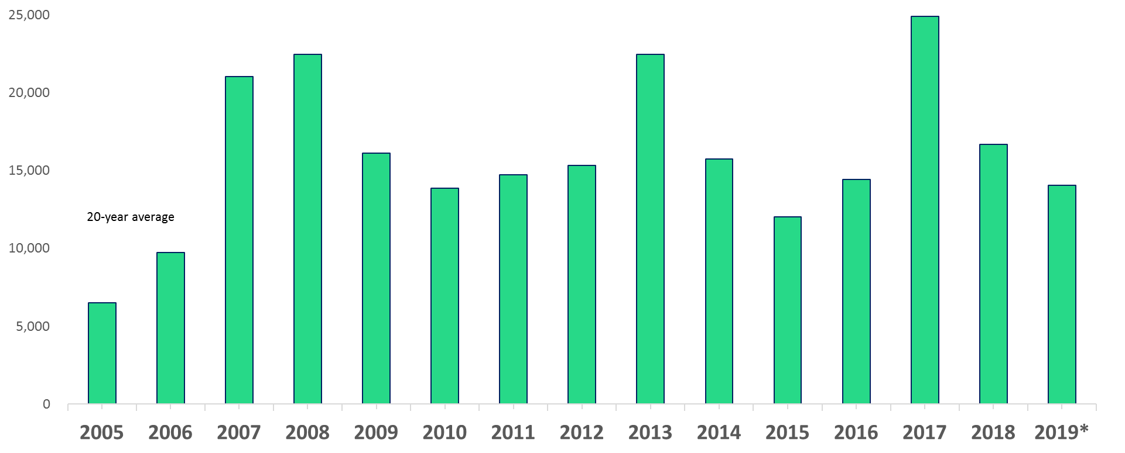
U.S. Used Class 8 Tractor Exports
2019 YTD, Mexico, Nigeria, and Guatemala account for 62% exports.
Units
* 2019 is a YTD annualized rate
Source: Census Bureau

Slide 24
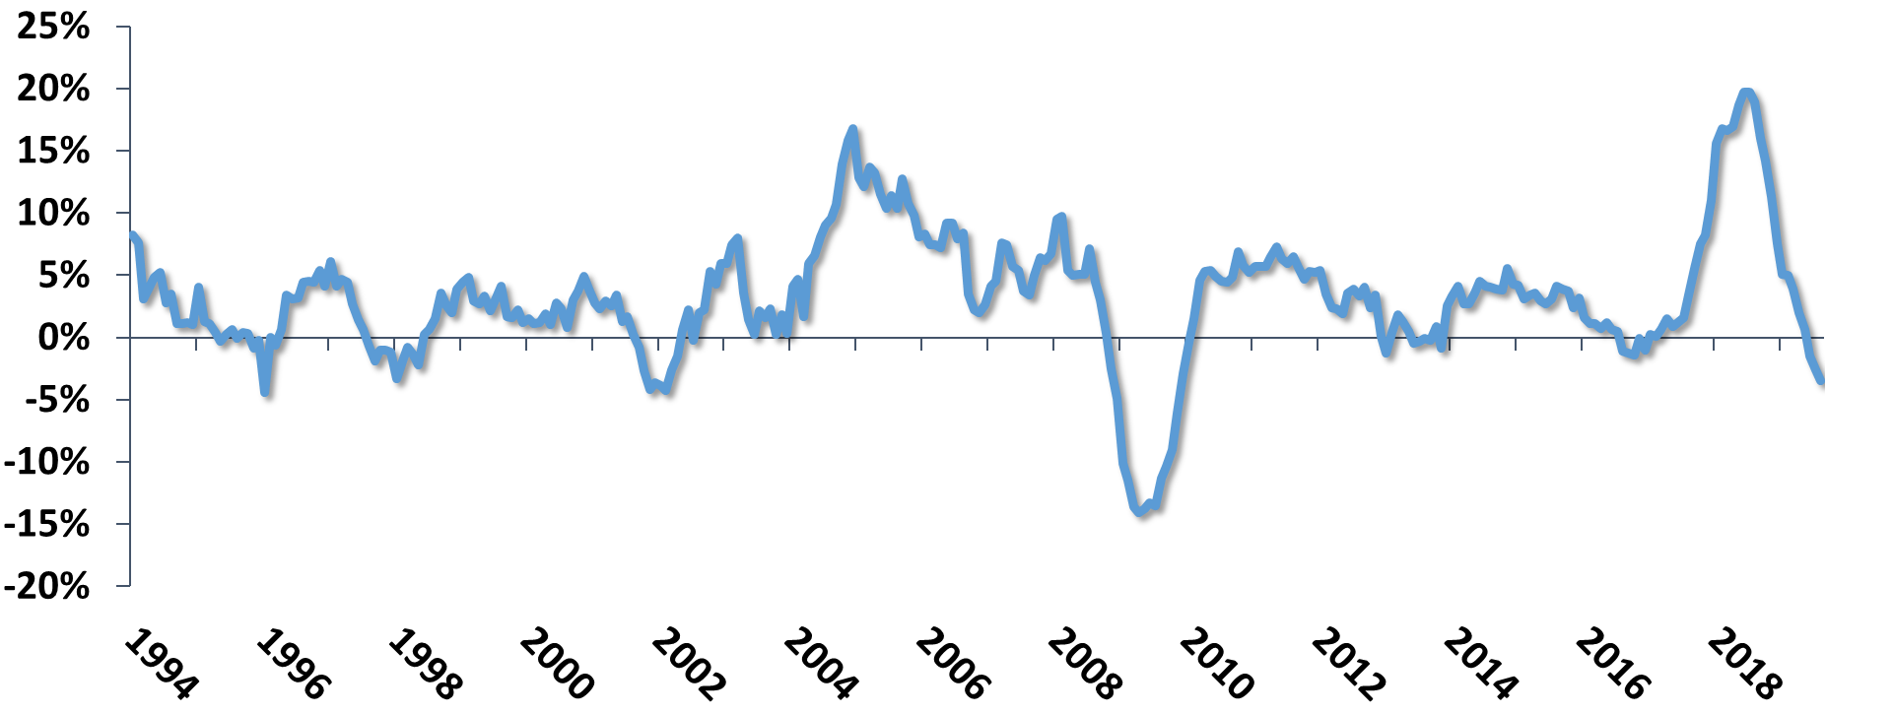
For-Hire Truckload Revenue per Mile
Year-Over-Year Growth
Primarily contract freight; includes very little spot market freight
Includes Dry Van, Flatbed, Temp Controlled, and Tank Truck
Excludes Fuel Surcharges
Source: ATA’s Trucking Activity Report

Slide 25
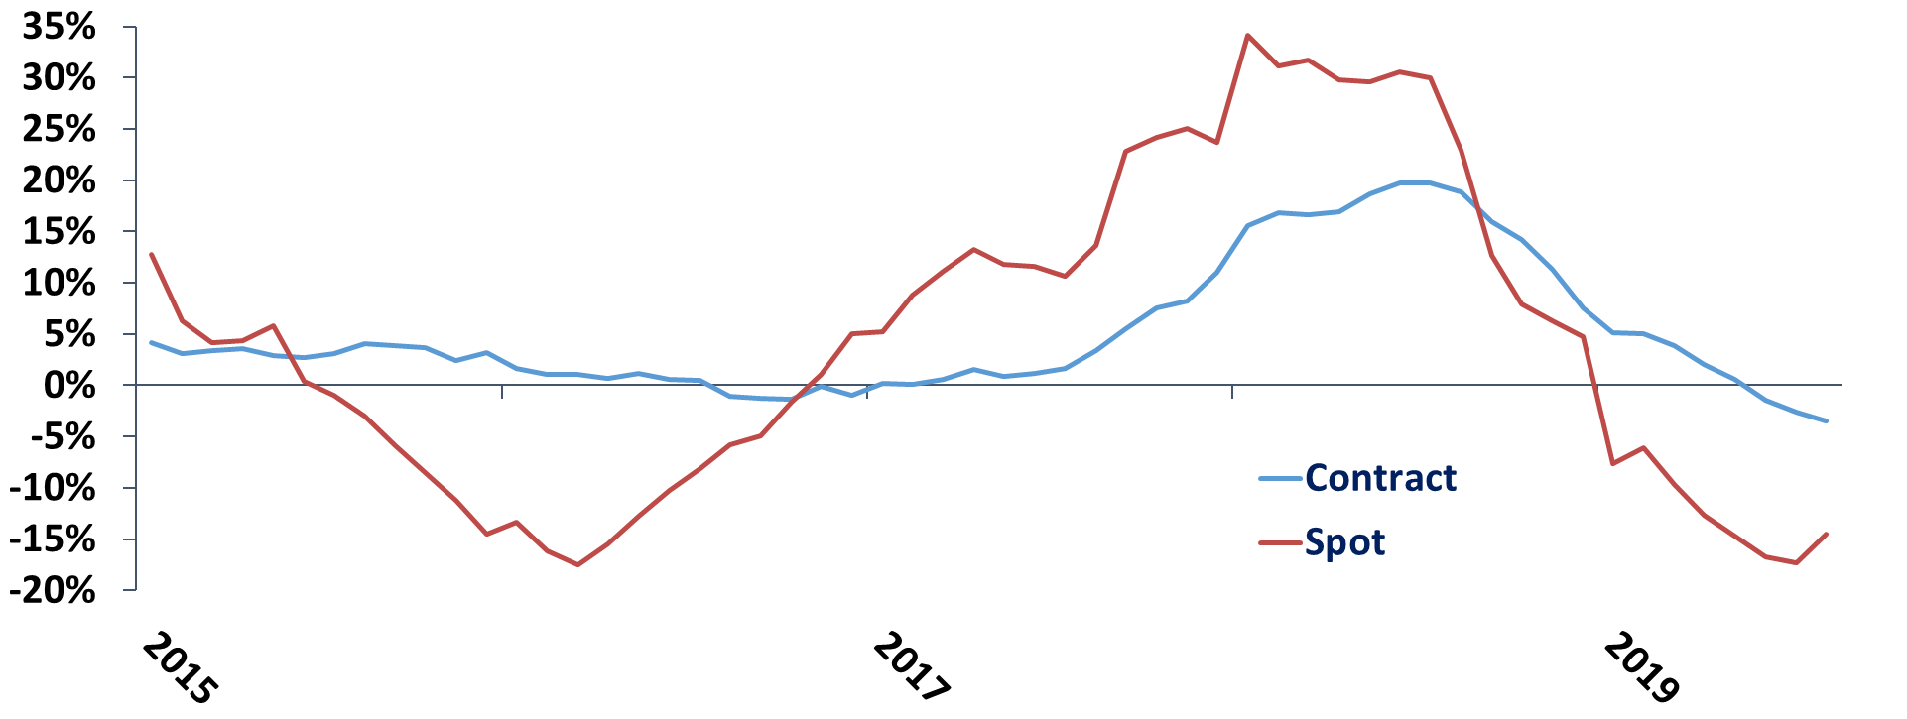
Contract Rev/Mile vs Spot Rates
Year-Over-Year Growth
Includes Dry Van, Flatbed, Temp Controlled, and Tank Truck
Excludes Fuel Surcharges
Source: ATA’s Trucking Activity Report & DAT.com

Slide 26
The Driver Situation

Slide 27
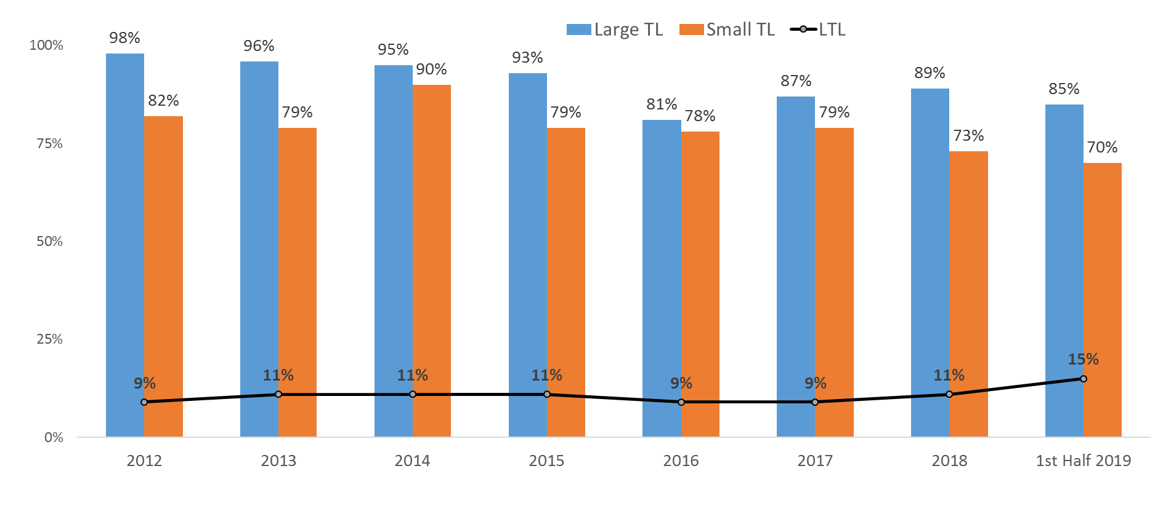
Truck Driver Turnover Rates
All rates are annualized
Source: ATA

Slide 28
10 Million CDL Holders
3.5 Million “Truck” Drivers
1.8 Million Heavy &
Tractor-Trailer Drivers
Based on government data, ATA estimates that there are roughly 500,000 - 600,000 OTR for-hire TL drivers.
880,710 For-Hire Trucking Heavy &
Tractor-Trailer Drivers

Slide 29
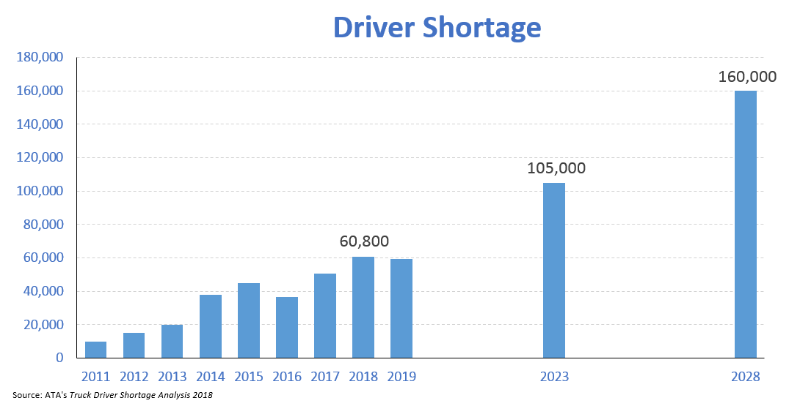
https://www.trucking.org/article/ATA-Releases-Updated-Driver-Shortage-Report-and-Forecast

Slide 30
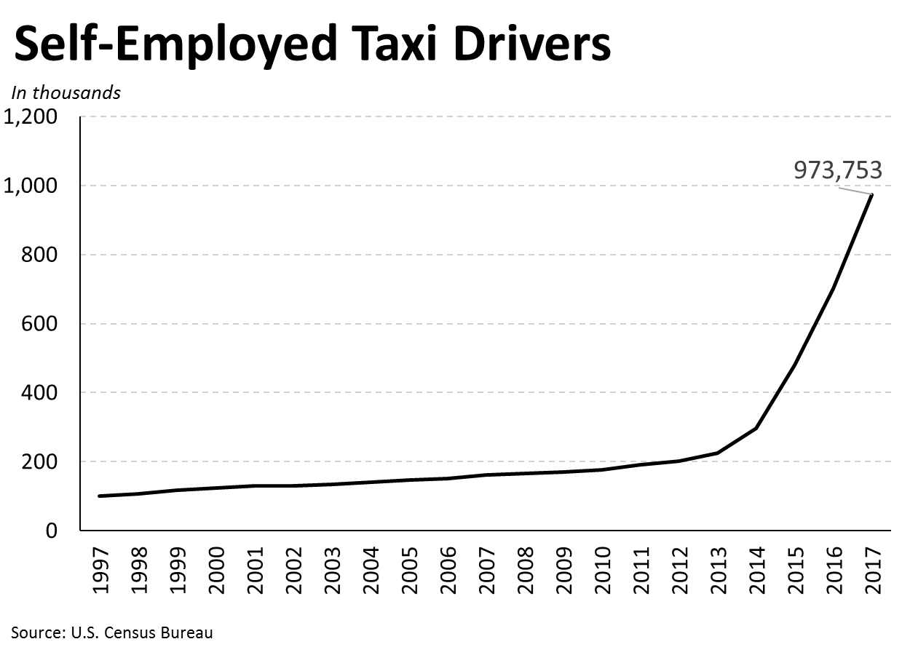
Causes of the Driver Shortage
Demographics
  Age
  Gender
Lifestyle
More job alternatives available
Regulations that reduce productivity

Slide 31
Driver Pay
The natural market reaction to any situation where demand outstrips supply is that price increases.
This is no different in the driver market. Pay rates have been, should be, and will continue to rise as long as demand is higher than supply.
However, pay rate increases have outpaced driver earnings as drivers are not getting all of the miles that they once did to due to the changing supply chain and other issues.
Fleets used to get 125,000 per year on their trucks now struggle to get 100,000 miles annually.

Slide 32
Impact on the Industry
Combination of higher driver pay rates, minimum pay guarantees, and soft to falling rates, especially in the spot market, will lead to:
  Significant amount of industry failures/closures – First half of 2019 failures was more than double all of 2018
  Not all of the fleets that have closed their doors have been small – New England Motor Freight (1,472); Falcon Transport (585); LME (424); Cold Carriers (339)

Slide 33
Thanks

